Slide 1


Horngren’s Financial & Managerial Accounting
Seventh Edition
Chapter 3
The Adjusting Process
Copyright © 2021 Pearson Education, Inc. All Rights Reserved
Notes:
If this PowerPoint presentation contains mathematical equations, you may need to check that your computer has the following installed:
1) MathType Plugin
2) Math Player (free versions available)
3) NVDA Reader (free versions available)

Slide 2

Chapter 3 Learning Objectives (1 of 2)
3.1 Differentiate between cash basis accounting and accrual basis accounting
3.2 Define and apply the time period concept, revenue recognition, and matching principles
3.3 Explain the purpose of and journalize and post adjusting entries
3.4 Explain the purpose of and prepare an adjusted trial balance

Slide 3
Chapter 3 Learning Objectives (2 of 2)
3.5 Identify the impact of adjusting entries on the financial statements
3.6 Explain the purpose of a worksheet and use it to prepare adjusting entries and the adjusted trial balance
3.7 Understand the alternative treatments of recording deferred expenses and deferred revenues (Appendix 3 A)

Slide 4

Learning Objective 3.1
Differentiate between cash basis accounting and accrual basis accounting

Slide 5
What Is the Difference Between Cash Basis Accounting and Accrual Basis Accounting? (1 of 3)
Cash basis accounting
Revenues are recorded when cash is received
Expenses are recorded when cash is paid
Not allowed under G A A P
Easier method to follow; requires less knowledge of accounting concepts and principles
Accrual basis accounting
Revenues are recorded when earned
Expenses are recorded when incurred
Used by most businesses
Provides a better picture of a business’s revenues and expenses
Notes:
There are two ways to record transactions: cash basis accounting and accrual basis accounting. Cash basis records transactions based upon the receipt or payment of cash. Under cash basis, revenues are recorded only when cash is received, and expenses are recorded only when cash payments are made.
Accrual basis records the effect of each transaction as it occurs—when revenues are earned and expenses are incurred. Therefore, revenue is recognized when the service is performed, not when the cash payment is received as the receipt of cash may occur at a later date.
Accrual basis accounting is required by Generally Accepted Accounting Principles (GAAP). Cash Basis accounting is not allowed under GAAP.

Slide 6
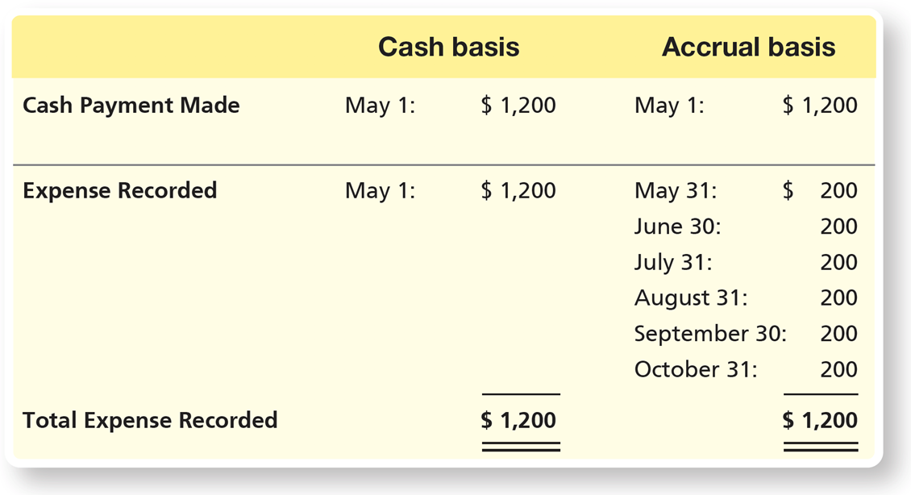
What Is the Difference Between Cash Basis Accounting and Accrual Basis Accounting? (2 of 3)
Example: On May 1, Smart Touch Learning paid $1,200 for insurance for the next six months ($200 per month).
Notes:
Suppose on May 1, Smart Touch Learning paid $1,200 for insurance for the next six months ($200 per month). This prepayment represents insurance coverage for May through October.
Under the cash basis method, Smart Touch Learning would record Insurance Expense of $1,200 on May 1. This is because the cash basis method records an expense when cash is paid.
Accrual basis accounting requires the company to prorate the expense. Smart Touch Learning would record a $200 expense every month from May through October.
The entry is as follows.
A table has 8 rows and 3 columns. The columns have the following headings from left to right. Blank , Cash basis , Accrual basis , . The row entries are as follows. Row 1. Blank , Cash payment made . Cash basis , May 1, $1200 . Accrual basis , May 1, $1200. Row 2. Blank , Expense recorded. Cash basis , May 1, $1200. Accrual basis , May 31, $200 . Row 3. Blank , Blank . Cash basis , Blank. Accrual basis , June 30, $200. Row 4. Blank , Blank . Cash basis , Blank. Accrual basis , July 31, $200 . Row 5. Blank , Blank. Cash basis , Blank. Accrual basis , August 31, $200. Row 6. Blank , Blank. Cash basis , Blank. Accrual basis , September 30, $200. Row 7. Blank , Blank. Cash basis , Blank. Accrual basis , October 31, $200. Row 8. Blank , Total expense recorded . Cash basis , $1200. Accrual basis , $1200 .

Slide 7
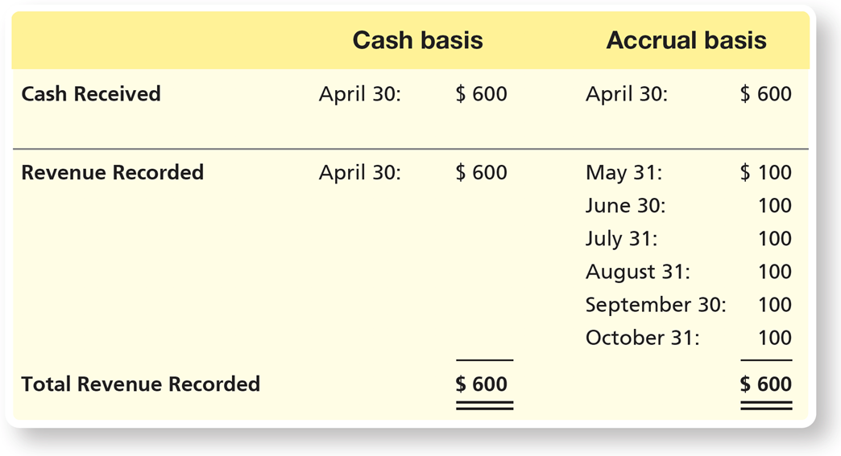
What Is the Difference Between Cash Basis Accounting and Accrual Basis Accounting? (3 of 3)
Example: On April 30, Smart Touch Learning received $600 for services to be performed for the next six months (May through October).
Notes:
Suppose on April 30, Smart Touch Learning received $600 for services to be performed for the next six months (May through October).
Under the cash basis method, Smart Touch Learning would record $600 of revenue when the cash is received on April 30.
The accrual basis method, though, requires the revenue to be recorded only when it is earned. Smart Touch Learning would record $100 of revenue each month for the next six months beginning in May.
Under both methods, cash basis and accrual basis, the total amount of revenues and expenses recorded by October 31 was the same. The major difference between a cash basis accounting system and an accrual basis accounting system is the timing of recording the revenue or expense.
The entry is as follows.
A table has 8 rows and 3 columns. The columns have the following headings from left to right. Blank , Cash basis , Accrual basis , . The row entries are as follows. Row 1. Blank , Cash received . Cash basis , April 30, $600 . Accrual basis , April 30, $600. Row 2. Blank , Revenue recorded . Cash basis , April 30, $600. Accrual basis , May 31, $100 . Row 3. Blank , Blank . Cash basis , Blank. Accrual basis , June 30, $100. Row 4. Blank , Blank . Cash basis , Blank. Accrual basis , July 31, $100 . Row 5. Blank , Blank. Cash basis , Blank. Accrual basis , August 31, $100. Row 6. Blank , Blank. Cash basis , Blank. Accrual basis , September 30, $100. Row 7. Blank , Blank. Cash basis , Blank. Accrual basis , October 31, $100. Row 8. Blank , Total revenue recorded . Cash basis , $600. Accrual basis , $600 .

Slide 8
Learning Objective 3.2
Define and apply the time period concept, revenue recognition, and matching principles

Slide 9
The Time Period Concept
The time period concept assumes business activities are sliced into small time segments and that financial statements can be prepared for specific periods, such as a month, quarter, or year.
A fiscal year is an accounting year of any 12 consecutive months that may or may not coincide with the calendar year.
Notes:
The time period concept simply states that a business’s activities can be sliced into small time segments, such as months, quarters, or years. Typically, a company’s fiscal year spans a period of 12 months. A calendar year is a fiscal year that begins on January 1 and ends on December 31. Many companies begin their fiscal year at the beginning of a quarter following a slow period. For example, retail organizations, such as Wal-Mart, J. C. Penney, Target, etc. may have a fiscal year from February 1 to January 31 since January is a slow month following the holiday season.

Slide 10
The Revenue Recognition Principle (1 of 3)
The revenue recognition principle tells accountants when to record revenue and requires companies follow a five-step process:
Step 1: Identify the contract with the customer.
A contract is an agreement between two or more parties that creates enforceable rights and obligations.
Step 2: Identify the performance obligations in the contract.
A performance obligation is a contractual promise with a customer to transfer a distinct good or service.
Notes:
Step 1: Identify the contract with the customer. A contract is an agreement between two or more parties that creates enforceable rights and obligations.
Step 2: Identify the performance obligations in the contract. A performance obligation is a contractual promise with a customer to transfer a distinct good or service. A contract might have multiple performance obligations. For example, AT&T, Inc. often provides a new phone to customers who sign a two-year cellular service agreement. This represents two distinct performance obligations: the cellular service agreement and the new phone.

Slide 11
The Revenue Recognition Principle (2 of 3)
Step 3: Determine the transaction price.
The transaction price is the amount that the entity expects to be entitled to as a result of transferring goods or services to the customer.
Step 4: Allocate the transaction price to the performance obligations in the contract.
If the transaction has multiple performance obligations, the transaction price will need to be allocated among the different performance obligations.
Notes:
Step 3: Determine the transaction price. The transaction price is the amount that the entity expects to be entitled to as a result of transferring goods or services to the customer.
Step 4: Allocate the transaction price to the performance obligations in the contract. If the transaction has multiple performance obligations, the transaction price will need to be allocated among the different performance obligations.

Slide 12
The Revenue Recognition Principle (3 of 3)
Step 5: Recognize revenue when (or as) the entity satisfies each performance obligation.
The business will recognize revenue when (or as) it satisfies each performance obligation by transferring a good or service to a customer.
A good or service is considered transferred when the customer obtains control of the good or service.
The amount of revenue recognized is the amount allocated to the satisfied performance obligation.
Notes:
Step 5: Recognize revenue when (or as) the entity satisfies each performance obligation. The business will recognize revenue when (or as) it satisfies each performance obligation by transferring a good or service to a customer. A good or service is considered transferred when the customer obtains control of the good or service. The amount of revenue recognized is the amount allocated to the satisfied performance obligation.

Slide 13
The Matching Principle
The matching principle guides accounting for expenses and ensures:
All expenses are recorded when they are incurred during the period.
Expenses are matched against the revenues of the period.
The goal is to compute an accurate net income or net loss for the time period.
Notes:
The matching principle (sometimes called the expense recognition principle) guides accounting for expenses and ensures that all expenses are recorded when they are incurred during the period and expenses are matched against the revenues of the period.
To match expenses against revenues means to subtract expenses incurred during one month from revenues earned during that same month. The goal is to compute an accurate net income or net loss for the time period.
Some expenses are easily linked to revenues: For example, Smart Touch Learning pays a commission to the employee who sells the e-learning company’s services. The commission expense is directly related to the e-learning company’s revenue earned.
Other expenses are not so easy to link to revenues: For example, Smart Touch Learning’s monthly rent expense occurs regardless of the revenues earned that month. The matching principle tells us to identify those expenses with a particular period, such as a month or a year, when the related revenue occurred. The business will record rent expense each month based on the rental agreement.

Slide 14
Learning Objective 3.3
Explain the purpose of and journalize and post adjusting entries

Slide 15
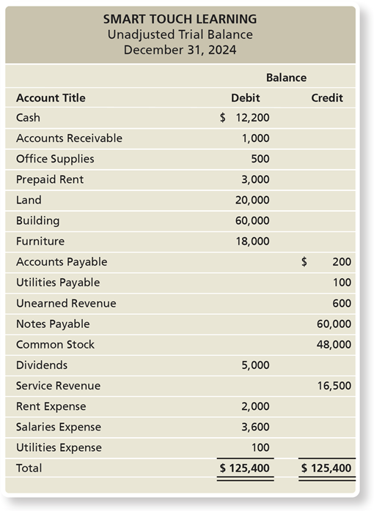
What Are Adjusting Entries, and How Do We Record Them? (1 of 3)
An unadjusted trial balance lists the revenues and expenses, but these amounts are incomplete because they omit various revenue and expense transactions.
Exhibit F:3-1 Unadjusted Trial Balance
Notes:
The end-of-period process begins with the trial balance. The unadjusted trial balance is incomplete because it omits various revenue and expense transactions in the account balances. Accrual basis accounting requires the business to review the unadjusted trial balance and determine whether any additional revenues and expenses need to be recorded. Are there revenues that Smart Touch Learning has earned that haven’t been recorded yet? Are there expenses that have occurred that haven’t been journalized?
The unadjusted trial balance is as follows.
Smart Touch Learning Unadjusted Trial Balance December 31, 2024
A table has 18 rows and 3 columns. The columns have the following headings from left to right. Account title , Debit balance , Credit balance , . The row entries are as follows. Row 1. Account title , Cash . Debit balance , $12,200 . Credit balance , Blank . Row 2. Account title , Accounts receivable . Debit balance , $1000. Credit balance , Blank . Row 3. Account title , Office supplies . Debit balance , $500 . Credit balance , Blank . Row 4. Account title , Prepaid rent . Debit balance , $3000. Credit balance , Blank . Row 5. Account title , Land . Debit balance , $20,000. Credit balance , Blank. Row 6. Account title , Building . Debit balance , $60,000. Credit balance , Blank. Row 7. Account title , Furniture . Debit balance , $18,000. Credit balance , Blank. Row 8. Account title , Accounts payable . Debit balance , Blank. Credit balance , $200. Row 9. Account title , Utilities payable . Debit balance , Blank. Credit balance , $100. Row 10. Account title , Unearned revenue . Debit balance , Blank. Credit balance , $600. Row 11. Account title , Notes payable . Debit balance , Blank. Credit balance , $60,000. Row 12. Account title , Bright, Capital . Debit balance , Blank. Credit balance , $48,000. Row 13. Account title , Bright, Withdrawal . Debit balance , $5,000. Credit balance , Blank. Row 14. Account title , Service revenue . Debit balance , Blank. Credit balance , $16,500 . Row 15. Account title , Rent expense . Debit balance , $2,000. Credit balance , Blank. Row 16. Account title , Salaries expense . Debit balance , $3,600. Credit balance , Blank. Row 17. Account title , Utilities expense . Debit balance , $100. Credit balance , Blank. Row 18. Account title , Total . Debit balance , $125,400. Credit balance , $125,400 .

Slide 16
What Are Adjusting Entries, and How Do We Record Them? (2 of 3)
Adjusting entries are made at the end of the accounting period to record revenues to the period in which they are earned and expenses to the period in which they occur.
Adjusting entries also update asset and liability accounts.
They are needed to properly measure items such as:
Net income (loss) on the income statement
Assets and liabilities on the balance sheet
The two basic categories are deferrals and accruals.
Notes:
Adjustments are needed to properly measure several items such as:
1. Net income (loss) on the income statement
2. Assets and liabilities on the balance sheet

Slide 17
What Are Adjusting Entries, and How Do We Record Them? (3 of 3)
Deferrals
Defer the recognition of revenue or expense to a date after the cash is received or paid
Two types of deferrals:
Deferred expenses
Deferred revenues
Accruals
Record an expense before the cash is paid, or records revenue before the cash is received
Two types of accruals:
Accrued expenses
Accrued revenues
Notes:
There are two basic categories of adjusting entries: deferrals and accruals. In a deferral adjustment, the cash payment occurs before an expense is incurred or the cash receipt occurs before the revenue is earned. Deferrals defer the recognition of revenue or expense to a date after the cash is received or paid. Accrual adjustments are the opposite. An accrual records an expense before the cash is paid, or it records the revenue before the cash is received.

Slide 18
Deferred Expenses (1 of 6)
Deferred expenses are advance payments of future expenses.
Also called prepaid expenses
Treated as assets until used
Recognized as an expense by an adjusting journal entry when the prepayment is used
Types of deferred expenses:
Prepaid rent
Office supplies
Depreciation
Notes:
A deferred expense is an item paid for in advance by the company for use in the future. Such payments are considered assets rather than expenses until they are used up. When the prepayment is used up, the used portion of the asset becomes an expense via an adjusting entry.

Slide 19
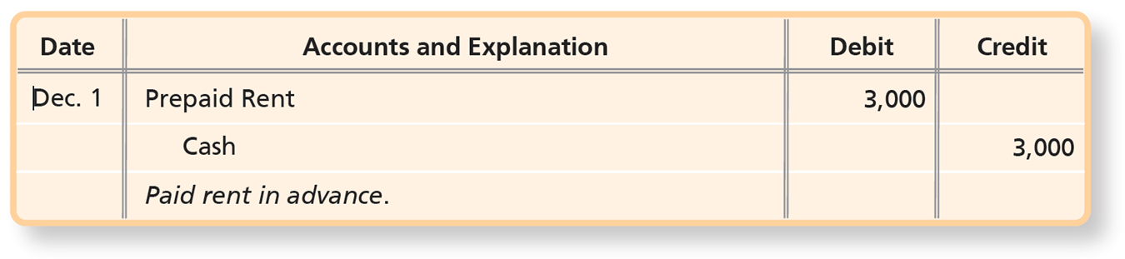
Deferred Expenses (2 of 6)
Prepaid Rent
Smart Touch Learning prepaid three months’ office rent of
on December 1,
2024.
Notes:
In Transaction 10 in Chapter 2, Smart Touch Learning prepaid for three months’ office rent of $3,000 ($1,000 per month * 3 months) on December 1. After posting, Prepaid Rent has a $3,000 debit balance.
The entry is as follows.
A table has 3 rows and 4 columns. The columns have the following headings from left to right. Date , Accounts and explanation , Debit , Credit . The row entries are as follows. Row 1. Date , December 1. Accounts and explanation , Prepaid rent . Debit , 3000. Credit , Blank . Row 2. Date , Blank. Accounts and explanation , Cash . Debit , Blank. Credit , 3000. Row 3. Date , Blank. Accounts and explanation , Paid rent in advance . Debit , Blank. Credit , Blank.

Slide 20

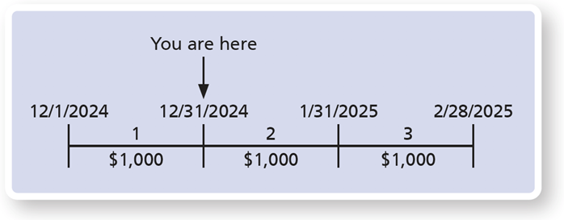
Deferred Expenses (3 of 6)
Prepaid Rent
Prepaid Rent has a $3,000 balance on December 1
As of December 31, Prepaid Rent should be decreased for the amount that has been used up.
Notes:
As of December 31, Prepaid Rent should be decreased for the amount that has been used up. The used-up portion is one month of the three months prepaid, or one-third of the prepayment.
The rent between the first period from 1st January 20 24 to 31st December 20 24 is $1,000. The rent between the second period from 31st December 20 24 to 31st December 20 25 is $1,000. The rent between the third period from 31st December 20 25 to 28th February 20 25 is $1,000. 31st December 20 24 is labeled you are here.

Slide 21
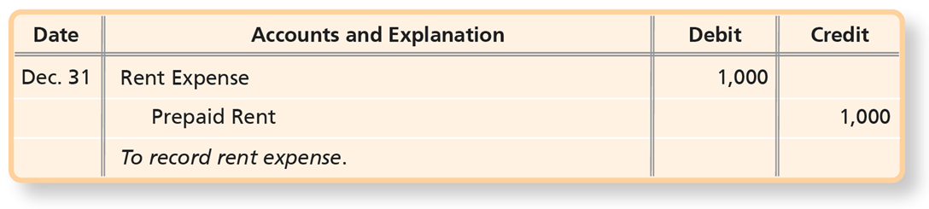
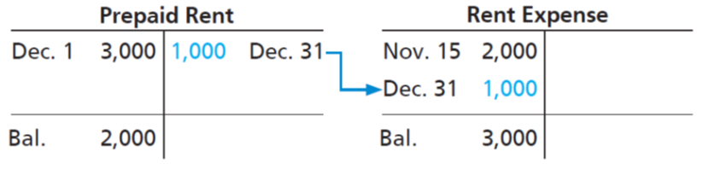
Deferred Expenses (4 of 6)
Prepaid Rent
The adjusting entry transfers
from Prepaid
Rent to Rent Expense.
After posting:
Notes:
Recall that an asset that has expired is an expense. The adjusting entry transfers $1,000 ($3,000 * 1/3) from Prepaid Rent to Rent Expense.
Prepaid Rent is an example of an asset that was overstated prior to journalizing and posting the adjusting entry.
The entry is as follows.
A table has 3 rows and 4 columns. The columns have the following headings from left to right. Date , Accounts and explanation , Debit , Credit . The row entries are as follows. Row 1. Date , December 31. Accounts and explanation , Rent expense . Debit , 1000. Credit , Blank . Row 2. Date , Blank. Accounts and explanation , Prepaid rent . Debit , Blank. Credit , 1000. Row 3. Date , Blank. Accounts and explanation , To record rent expense . Debit , Blank. Credit , Blank.
Debit: December 1, 3,000. Credit: 1,000, December 31. Ending Debit balance: 2,000. The amount credited is included in the rent expense T-Account. T-account: Rent expense. Debit: November 15, 2,000, Debit: December 31, 1,000. Ending debit balance: 3,000.

Slide 22
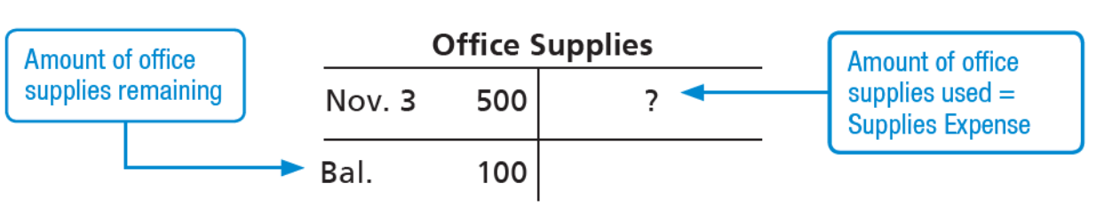
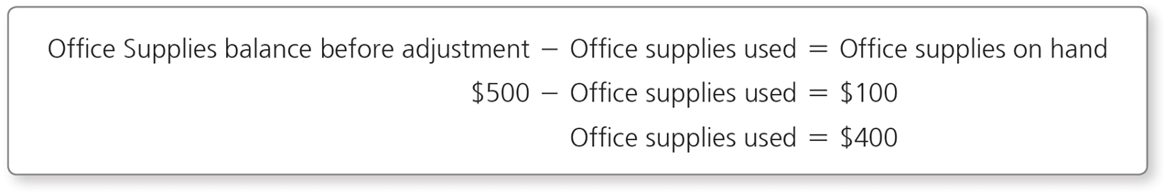
Deferred Expenses (5 of 6)
Office Supplies
On November 3, Smart Touch Learning purchased $500 of supplies on account. As of December 31, $100 of supplies remain on hand.
Notes:
The December 31 unadjusted trial balance for Smart Touch Learning shows a balance in Office Supplies of $500. This represents the amount of office supplies that were purchased earlier in the period. Assume the ending balance of supplies is $100, which was found by counting the office supplies on hand at the end of the month. Since there are only $100 of supplies left on hand, the company has used $400 worth of supplies (found by taking $500 beginning balance ‒ $100 ending balance).
This would mean that the current Office Supplies balance of $500 is no longer a fair representation of the amount of office supplies that Smart Touch Learning currently owns. Therefore, the adjusting journal entry is needed to properly report the correct balance of Office Supplies on the balance sheet.

Slide 23
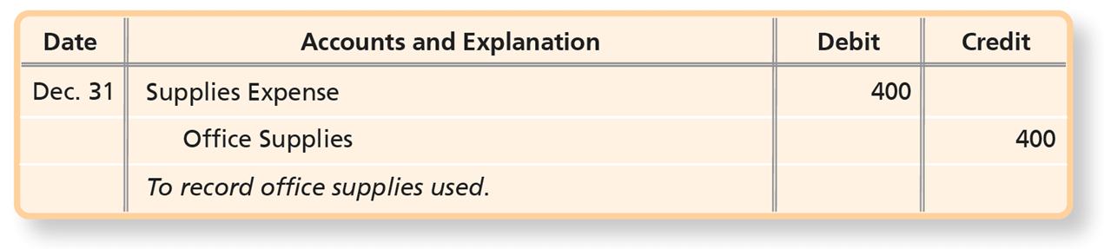
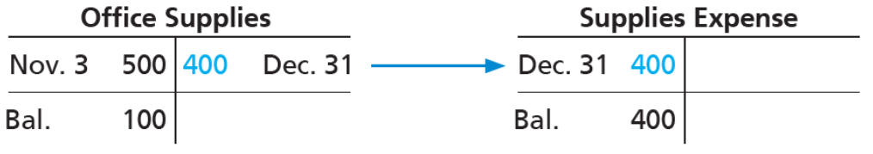
Deferred Expenses (6 of 6)
Office Supplies
The December 31 adjusting entry should be:
After posting:
Notes:
The December 31 adjusting entry updates Office Supplies and records Supplies Expense for November and December. After posting the adjusting entry, the December 31 balance of Office Supplies is correctly reflected as $100 and the Supplies Expense is correctly reflected as $400.
The Office Supplies account then enters January with a $100 balance. If the adjusting entry for Office Supplies had not been recorded, the asset would have been overstated and Supplies Expense would have been understated.
The entry is as follows.
A table has 3 rows and 4 columns. The columns have the following headings from left to right. Date , Accounts and explanation , Debit , Credit . The row entries are as follows. Row 1. Date , December 31. Accounts and explanation , Supplies expense . Debit , 400. Credit , Blank . Row 2. Date , Blank . Accounts and explanation , Office supplies . Debit , Blank . Credit , 400. Row 3. Date , Blank. Accounts and explanation , To record office supplies used . Debit , Blank. Credit , Blank.
T-account: office supplies. Line 1, November 3, 500. Credit, 400, December 31. 400 credit is used in supplies expense t-account in the debit column. Line 2, debit, balance, 100. T-account: supplies expense. Line 1, debit, December 31, 400. Credit, blank. Line 2, debit, balance, 400.

Slide 24
Depreciation (1 of 9)
Property, plant, and equipment represent long-lived, tangible assets used in the operations of the business.
Examples: Land, Buildings, Equipment
The allocation of plant asset’s cost over its useful life is called depreciation.
The adjusting entry records cost allocation to Depreciation Expense.
Accounting for plant assets is similar to prepaid expenses.
The expected value of a depreciable asset at the end of its useful life is called the residual value.
Notes:
Property, plant and equipment are also called plant assets.
Most prepaid adjusting journal entries are related to the adjustment of a current asset account. However, long-lived tangible assets are also used in the operations of the business. They act much like other prepaid assets, except adjustments will be made to the plant assets over a number of years instead of one or two years through Depreciation Expense.
Depreciation is a type of prepaid expense adjustment. Plant assets are recorded in full at the time of purchase; therefore, an adjustment is recorded to reduce the value of the asset over its useful life. The prepaid adjustment for plant assets is called depreciation. The expected value of a depreciable asset at the end of its useful life is called the residual value.

Slide 25
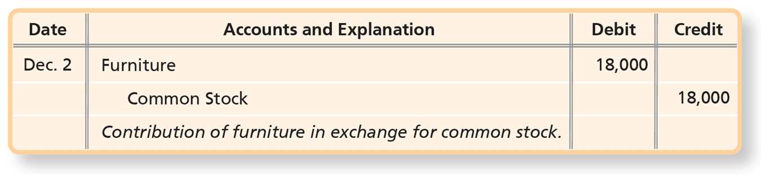
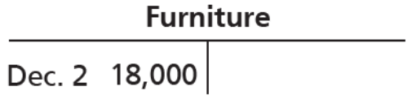
Depreciation (2 of 9)
On December 2, Smart Touch Learning received a contribution of furniture with a market value of $18,000 from Sheena Bright in exchange for shares of stock.
After posting:
Notes:
In Chapter 2 on December 2, Smart Touch Learning received a contribution of furniture having a market value of $18,000 from a stockholder. The original entry included a debit to the Furniture account on the balance sheet and a credit to the Common Stock account.
The entry is as follows.
A table has 3 rows and 4 columns. The columns have the following headings from left to right. Date , Accounts and explanation , Debit , Credit . The row entries are as follows. Row 1. Date , December 2. Accounts and explanation , Furniture . Debit , 18000. Credit , Blank. Row 2. Date , Blank. Accounts and explanation , Bright, Capital . Debit , Blank. Credit , 18000. Row 3. Date , Blank. Accounts and explanation , Owner contribution of furniture . Debit , Blank. Credit , Blank.

Slide 26
Depreciation (3 of 9)
The straight-line method allocates an equal amount of depreciation each year and is calculated as:
Smart Touch Learning believes the furniture will remain useful for five years and have no value at the end of its life. The straight-line method is used for depreciation.
Notes:
The straight-line method allocates an equal amount of depreciation each year and is calculated as: (Cost-Residual value)/Useful life

Slide 27
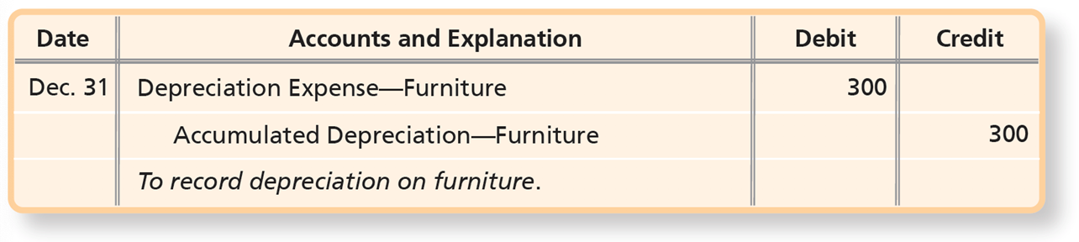
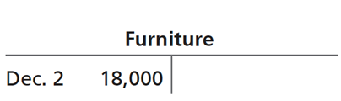
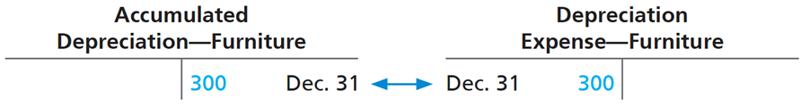
Depreciation (4 of 9)
Depreciation expense for December is recorded with the following adjusting entry:
After posting:
Notes:
Notice that in the above adjusting entry for depreciation, we credited Accumulated Depreciation—Furniture and not the asset account Furniture. Why? We need to keep the original cost of the furniture separate from the accumulated depreciation because of the cost principle. Managers can then refer to the Furniture account to see how much the asset originally cost. This information may help decide how much to sell the asset for in the future or how much to pay for new furniture.
The Accumulated Depreciation account accumulates the depreciation expense. This means that next month an additional $300 will be added to the Accumulated Depreciation—Furniture account creating a balance of $600, representing two months of depreciation. At the end of three months, the Accumulated Depreciation—Furniture account will have a balance of $900 ($300 per month x 3 months).
The entry is as follows.
A table has 3 rows and 4 columns. The columns have the following headings from left to right. Date , Accounts and explanation , Debit , Credit . The row entries are as follows. Row 1. Date , December 31. Accounts and explanation , Depreciation expense- furniture . Debit , 300. Credit , Blank. Row 2. Date , Blank. Accounts and explanation , Accumulated depreciation-furniture . Debit , Blank. Credit , 300. Row 3. Date , Blank. Accounts and explanation , To record depreciation on furniture . Debit , Blank. Credit , Blank.
A table has 1 rows and 0 columns. The columns have the following headings from left to right. The row entries are as follows. Row 1. , Blank . , December 31, 300.
The third T account for depreciation expense furniture is as follows.
A table has 1 rows and 0 columns. The columns have the following headings from left to right. The row entries are as follows. Row 1. , December 31, 300. , Blank .

Slide 28
Depreciation (5 of 9)
The Accumulated Depreciation account is the sum of all depreciation expense recorded for the depreciable asset to date.
It is a contra asset.
A contra account has two main characteristics:
It is paired with and is listed immediately after its related account in the chart of accounts and associated financial statement.
Its normal balance (debit or credit) is the opposite of the normal balance of the related account.
Notes:
A business may have a separate Accumulated Depreciation account for each depreciable asset. However, small companies often have only one Accumulated Depreciation account for all of their depreciable assets.

Slide 29
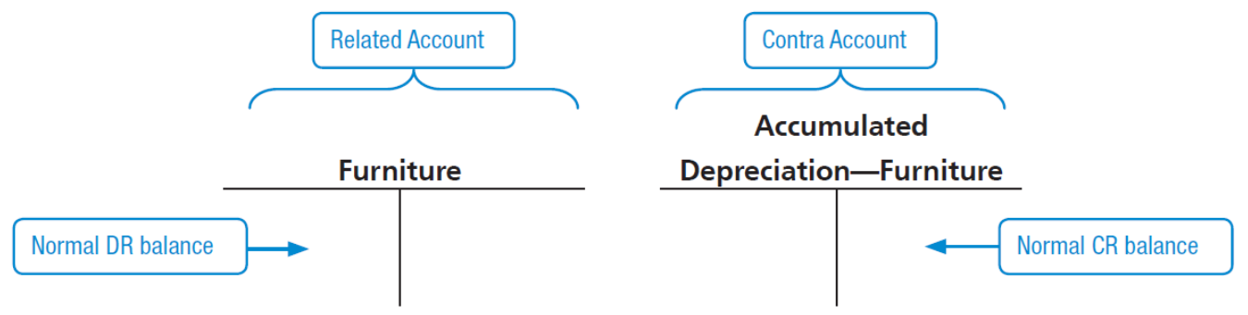
Depreciation (6 of 9)
Example: Accumulated Depreciation—Furniture is the contra account that follows the Furniture account on the balance sheet.
Notes:
Accumulated Depreciation—Furniture is the contra account that follows the Furniture account on the balance sheet. The Furniture account has a normal debit balance, so Accumulated Depreciation—Furniture, a contra asset, has a normal credit balance.
A business may have a separate Accumulated Depreciation account for each depreciable asset, or it may have only one Accumulated Depreciation account for all depreciable assets.
The furniture t-account is the related account. The debit column is the normal D R balance. The accumulated depreciation furniture t-account is the contra account. The credit column is the normal C R balance.

Slide 30
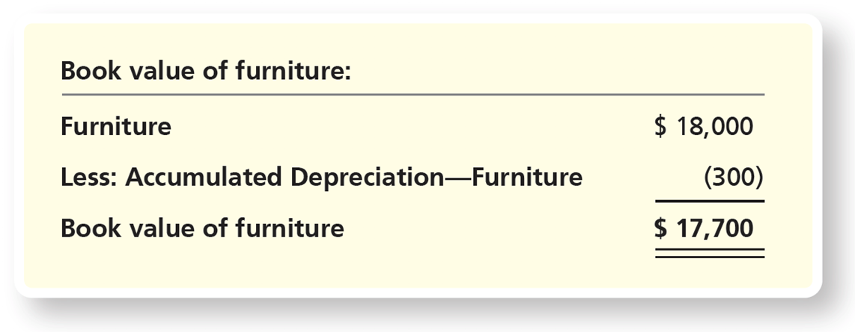
Depreciation (7 of 9)
Book value is a depreciable asset’s cost minus accumulated depreciation.
Book value of Smart Touch Learning’s furniture on December 31:
Notes:
The balance sheet reports both Furniture and Accumulated Depreciation—Furniture. Because it is a contra account, Accumulated Depreciation—Furniture is subtracted from Furniture. The resulting net amount (cost minus accumulated depreciation) of a plant asset is called its book value. The book value represents the cost invested in the asset that the business has not yet expensed.
The entries are as follows.
A table has 3 rows and 2 columns. The columns have the following headings from left to right. Book value of furniture , Blank . The row entries are as follows. Row 1. Book value of furniture , Furniture . Blank , $18,000. Row 2. Book value of furniture , Less, accumulated depreciation, furniture . Blank , Negative 300. Row 3. Book value of furniture , Book value of furniture . Blank , $17,700.

Slide 31
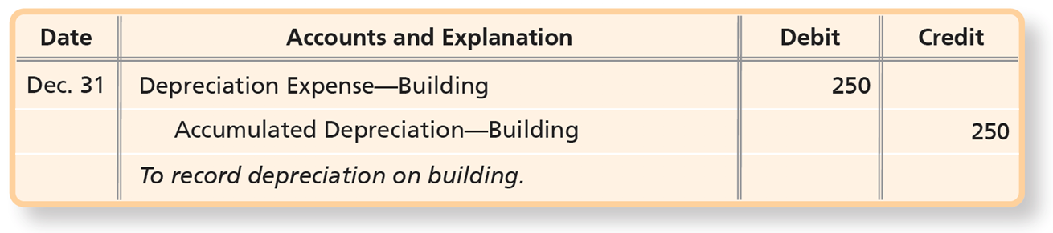
Depreciation (8 of 9)
Suppose that Smart Touch Learning purchased a building on December 1. The monthly depreciation is $250. The following adjusting entry would record depreciation for December:
Notes:
Suppose that Smart Touch Learning purchased a building on December 1. The monthly depreciation is $250. The adjusting entry would record depreciation for December by debiting Depreciation Expense-Building and crediting Accumulated Depreciation-Building for $250.
The entries are as follows.
A table has 3 rows and 4 columns. The columns have the following headings from left to right. Date , Accounts and explanation , Debit , Credit . The row entries are as follows. Row 1. Date , December 31. Accounts and explanation , Depreciation expense- building . Debit , 250. Credit , Blank. Row 2. Date , Blank. Accounts and explanation , Accumulated depreciation - building . Debit , Blank. Credit , 250. Row 3. Date , Blank. Accounts and explanation , To record depreciation on building . Debit , Blank. Credit , Blank.

Slide 32
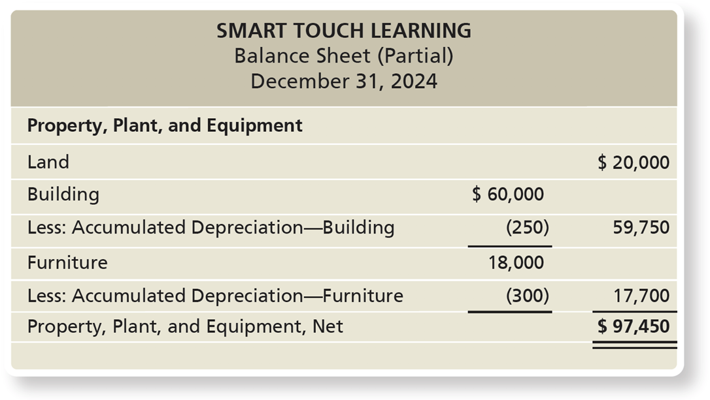
Depreciation (9 of 9)
Exhibit F:3-2 Property, Plant, and Equipment on the Balance Sheet of Smart Touch Learning
Notes:
Had Smart Touch Learning not recorded the adjusting entries for depreciation on the furniture and building, plant assets would have been overstated and expenses would have been understated. After recording the adjusting entries, plant assets are reported at the correct net amount, as shown on the December 31 partial balance sheet in Exhibit F:3-2.
The cost principle requires the plant asset account to maintain the cost value in the asset account. However, the corresponding contra account is reported in the assets section of the balance sheet. The plant asset and corresponding accumulated depreciation accounts are netted so that the depreciated value (i.e., book value) of the asset is reported properly in the assets section of the balance sheet.
The balance sheet is as follows.
Smart Touch Learning Balance Sheet (Partial) December 31, 2024
A table has 7 rows and 0 columns. The columns have the following headings from left to right. The row entries are as follows. Row 1. , Property, plant and equipment . , Blank. , Blank. Row 2. , Land . , Blank. , $12,000. Row 3. , Building . , $60,000. , Blank. Row 4. , Less, accumulated depreciation building . , Negative 250. , 59750. Row 5. , Furniture. , 18000. , Blank. Row 6. , Less accumulated depreciation furniture . , Negative 300 . , 17700. Row 7. , Property, plant and equipment, Net. , Blank. , $97,450.

Slide 33
Deferred Revenues (1 of 3)
Deferred revenue:
Occurs when a company receives cash before it does the work or delivers a product
Is a liability because the business owes the customer the product, the service, or a refund
Also called unearned revenue
Upon performance or delivery, deferred revenue is converted to earned revenue.
Notes:
Deferred revenues occur when a company receives cash from a customer prior to performing services or delivering a product. For example, an attorney requires a new client to pay a retainer fee of $1,000, yet no services have been performed. The attorney debits Cash and credits Unearned Revenue to establish the liability. If the client decides to not use the attorney, he or she can request a refund. Upon performance of the service, the revenue will be recognized.
Deferred revenues arise when the company receives payment from a customer prior to services being performed or products being delivered. Since the company has not yet performed the service or delivered the product, the customer has a right to request a refund; therefore, the company still “owes” the customer either performance or money back. Therefore, a prepayment from a customer is considered a liability.

Slide 34
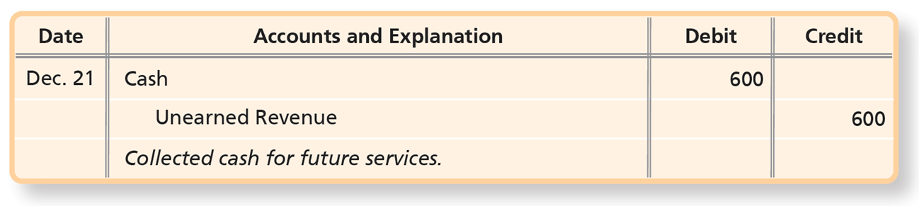
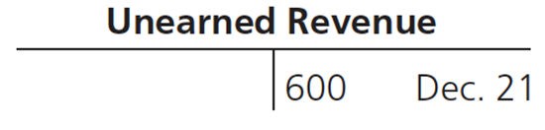
Deferred Revenues (2 of 3)
On December 21, a law firm engages Smart Touch Learning to provide e-learning services for the next 30 days, paying $600 in advance.
Notes:
On December 21, a law firm engages Smart Touch Learning to provide e-learning services for the next 30 days, paying $600 in advance. Cash is debited for $600 and Unearned Revenue is credited for $600.
The entry is as follows.
A table has 3 rows and 4 columns. The columns have the following headings from left to right. Date , Accounts and explanation , Debit , Credit . The row entries are as follows. Row 1. Date , December 21. Accounts and explanation , Cash . Debit , 600. Credit , Blank. Row 2. Date , Blank. Accounts and explanation , Unearned revenue . Debit , Blank. Credit , 600. Row 3. Date , Blank. Accounts and explanation , Collected cash for future services . Debit , Blank. Credit , Blank.

Slide 35
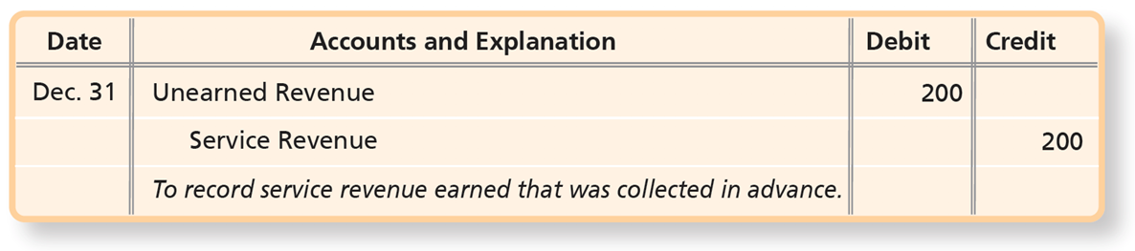
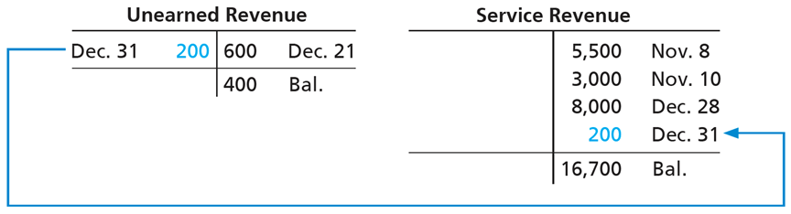
Deferred Revenues (3 of 3)
During the last 10 days of the month, Smart Touch Learning
will earn
of the revenue. Adjusting entry:
After posting:
Notes:
During the last 10 days of the month—December 22 through December 31—Smart Touch Learning will earn approximately one-third (10 days divided by 30 days) of the $600, or $200. Therefore, Smart Touch Learning makes an adjusting entry to record earning $200 of revenue. This adjusting entry shifts $200 from the liability account to the revenue account. Service Revenue increases by $200, and Unearned Revenue decreases by $200. Had the adjusting entry not been made, the liability, Unearned Revenue, would be overstated and Service Revenue would be understated.
The entries are as follows.
A table has 3 rows and 4 columns. The columns have the following headings from left to right. Date , Accounts and explanation , Debit , Credit . The row entries are as follows. Row 1. Date , December 31.. Accounts and explanation , Unearned revenue . Debit , 200. Credit , Blank. Row 2. Date , Blank. Accounts and explanation , Service revenue . Debit , Blank. Credit , 200. Row 3. Date , Blank. Accounts and explanation , To record service revenue earned that was collected in advance . Debit , Blank. Credit , Blank.
The T account for unearned revenue is as follows.
A table has 1 rows and 2 columns. The columns have the following headings from left to right. December 31, 200, December 21, 600. The row entries are as follows. Row 1. December 31, 200, Blank. December 21, 600, Balance, 400.
The T account for service revenue is as follows. A table has 4 rows and 2 columns. The columns have the following headings from left to right. Blank, November 8, 55,00. The row entries are as follows. Row 1. Blank, Blank. November 8, 55,00, November 10, 3,000. Row 2. Blank, Blank. November 8, 55,00, December 28, 8,000. Row 3. Blank, Blank. November 8, 55,00, December 31, 200. Row 4. Blank, Blank. November 8, 55,00, Balance, 16,700.
The entry of December 31 in unearned revenue account connects to the entry of December 31 in service revenue account.

Slide 36
Accrued Expenses
Accrued expenses are expenses a business has incurred but has not yet paid.
Examples of accrued expenses:
Salaries Expense
Interest Expense
Utilities Expense
Notes:
Businesses often incur expenses prior to paying for them. An accrued expense hasn’t been paid for yet. A great example is Salaries Expense: Employees work for a period of time before the business pays them for their time. This is an example of receiving a service prior to providing payment.

Slide 37
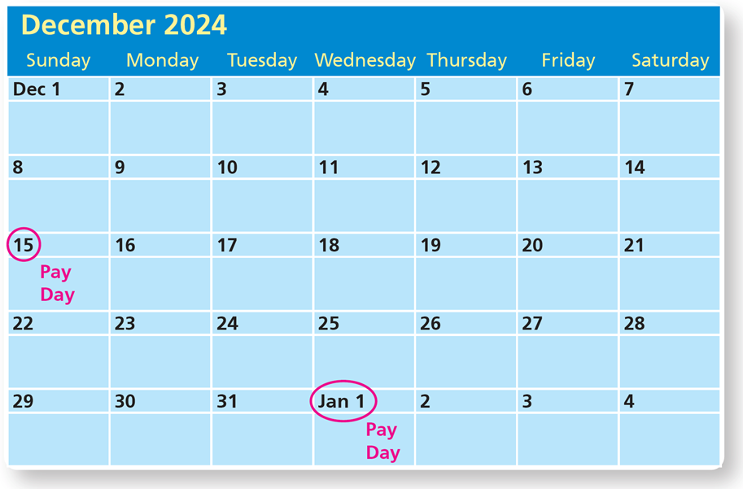
Accrued Salaries Expense (1 of 4)
Smart Touch Learning pays its employee a monthly salary of $2,400—half on the 15th and half on the first day of the next month.
Notes:
Assume that Smart Touch Learning normally pays its employee a monthly salary of $2,400. Smart Touch Learning typically pays half the salary on the 15th of the month and the remainder on the first day of the next month.

Slide 38
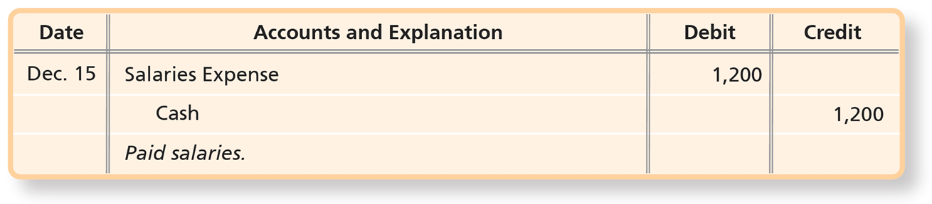
Accrued Salaries Expense (2 of 4)
During December, the company paid the first half-month salary on Thursday, December 15, and made this entry:
Notes:
During December, the company paid the first half-month salary on Thursday, December 15. The entry debits Salaries Expense and credits Cash for $1,200.
The entry is as follows.
A table has 3 rows and 4 columns. The columns have the following headings from left to right. Date , Accounts and explanation , Debit , Credit . The row entries are as follows. Row 1. Date , December 15.. Accounts and explanation , Salaries expense . Debit , 12,00. Credit , Blank. Row 2. Date , Blank. Accounts and explanation , Cash . Debit , Blank. Credit , 1200. Row 3. Date , Blank. Accounts and explanation , Paid salaries . Debit , Blank. Credit , Blank.

Slide 39
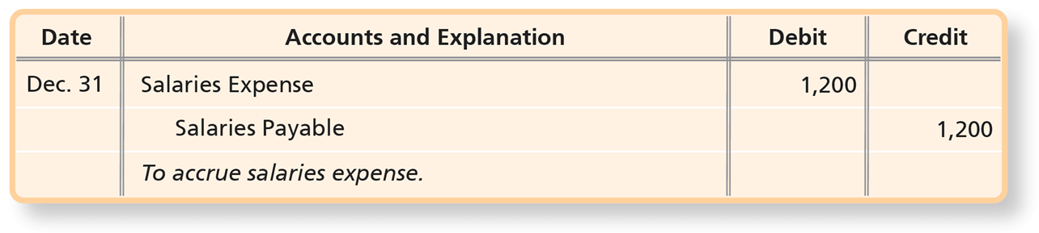
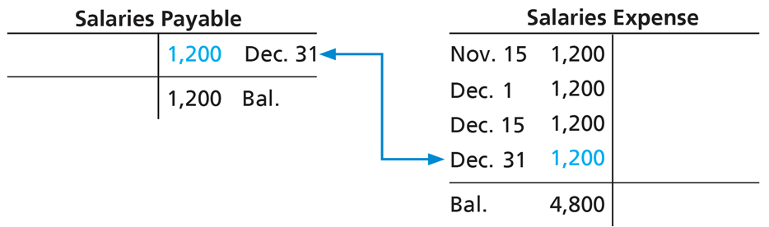
Accrued Salaries Expense (3 of 4)
Adjusting entry on December 31:
After posting:
Notes:
The December 15 entry records only the first half of December’s salaries expense. The second payment of $1,200 will occur on January 1; however, the expense was incurred in December, so the expense must be recorded in December.
The adjusting entry to record salaries accrued during the month of December is a debit to Salaries Expense and a credit to Salaries Payable of $1,200 (found by taking the monthly salary of $2,400 / 2 pay periods). The accrual is necessary because the company has incurred the expense since the employee has performed the work. When the payment is made on January 1, the Salaries Payable account will be debited, effectively eliminating the liability, and Cash will be credited.
This is an example of a liability that was understated before the adjusting entry was made. It also is an example of the matching principle: We are recording December’s Salaries Expense in December so it will be reported on the same income statement as December’s revenues.
The entry is as follows.
A table has 3 rows and 4 columns. The columns have the following headings from left to right. Date , Accounts and explanation , Debit , Credit . The row entries are as follows. Row 1. Date , December 31. Accounts and explanation , Salaries expense . Debit , 1200. Credit , Blank. Row 2. Date , Blank. Accounts and explanation , Salaries payable . Debit , Blank. Credit , 1200. Row 3. Date , Blank. Accounts and explanation , To accrue salaries expense . Debit , Blank. Credit , Blank.
The salaries payable account is as follows.
A table has 1 rows and 2 columns. The columns have the following headings from left to right. Blank , December 31, 1,200. The row entries are as follows. Row 1. Blank , Blank . December 31, 1,200, Balance, 1,200 .
The salaries expense is as follows.
A table has 4 rows and 2 columns. The columns have the following headings from left to right. November 15, 1,200, Blank. The row entries are as follows. Row 1. November 15, 1,200, December 1, 1,200 . Blank, Blank. Row 2. November 15, 1,200, December 15, 1,200. Blank, Blank. Row 3. November 15, 1,200, December 31, 1,200 . Blank, Blank. Row 4. November 15, 1,200, Balance, 4,800 . Blank, Blank. The entry of December 31 in salaries payable account connects to the entry of December 31 in salaries expense account.

Slide 40
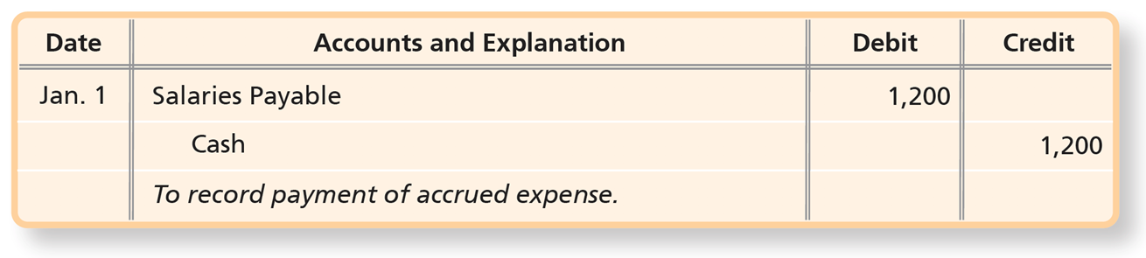
Accrued Salaries Expense (4 of 4)
The adjusting entry at December 31 creates a liability that will be paid on January 1.
Notes:
Don’t confuse this entry with an adjusting entry. Adjusting entries are recorded only at the end of the accounting period and are used to record either revenue earned or expenses incurred. This entry is a journal entry. It is simply recording an everyday business transaction—the payment of salaries previously accrued. In this example, the amount paid for salaries was equal to the amount of the liability in the adjusting entry.
The entry is as follows.
A table has 3 rows and 4 columns. The columns have the following headings from left to right. Date , Accounts and explanation , Debit , Credit . The row entries are as follows. Row 1. Date , January 1. Accounts and explanation , Salaries payable . Debit , 1200. Credit , Blank. Row 2. Date , Blank. Accounts and explanation , Cash . Debit , Blank. Credit , 1200. Row 3. Date , Blank. Accounts and explanation , To record payment of accrued expense. Debit , Blank. Credit , Blank.

Slide 41
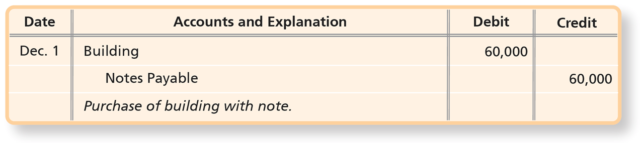
Accrued Interest Expense (1 of 3)
On December 1, Smart Touch Learning purchased a $60,000 building in exchange for a one-year loan.
Notes:
Companies often borrow money for purchase of equipment or buildings. The interest on the loan could be paid monthly, quarterly, or annually. Regardless of when the interest expense is actually paid, a business must accrue the interest expense owed but not yet paid each month. The entry to record accrued interest is a debit to Interest Expense and a credit to Interest Payable. When the interest is paid, Interest Payable will be debited, and Cash will be credited.
The above example illustrates the following: On December 1, 2024, Smart Touch Learning purchased a $60,000 building in exchange for a loan.
The entry is as follows.
A table has 3 rows and 4 columns. The columns have the following headings from left to right. Date , Accounts and explanation , Debit , Credit . The row entries are as follows. Row 1. Date , December 1. Accounts and explanation , Building . Debit , 60000. Credit , Blank. Row 2. Date , Blank. Accounts and explanation , Notes payable . Debit , Blank. Credit , 60000. Row 3. Date , Blank. Accounts and explanation , Purchase of building with note . Debit , Blank. Credit , Blank.

Slide 42
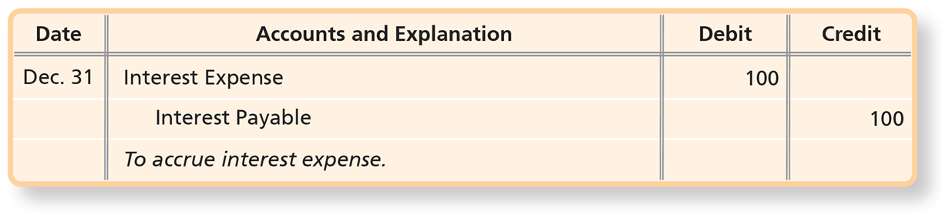
Accrued Interest Expense (2 of 3)
The formula for computing the interest is as follows:
The company must record an adjusting entry for the $100 of interest expense that has been incurred by December 31.
Notes:
Interest on the $60,000 note is payable one year after it is taken out. Although the company won’t make the interest payment for a year, the company must record the amount of interest expense that has been incurred by December 31, 2024. The company will make an adjusting entry to record interest expense for one month (December 1–December 31). In the formula, time (period) represents the portion of a year that interest has accrued on the note. It may be expressed as a fraction of a year in months (number of months/12) or a fraction of a year in days (number of days/365). This keeps the units for interest and time the same. The note payable has an interest rate of 2% per year so the time accrued is expressed as 1/12 of a year.
The entry is as follows.
A table has 3 rows and 4 columns. The columns have the following headings from left to right. Date , Accounts and explanation , Debit , Credit . The row entries are as follows. Row 1. Date , December 31. Accounts and explanation , Interest expense . Debit , 100. Credit , Blank. Row 2. Date , Blank. Accounts and explanation , Interest payable . Debit , Blank. Credit , 100. Row 3. Date , Blank. Accounts and explanation , To accrue interest expense . Debit , Blank. Credit , Blank.

Slide 43
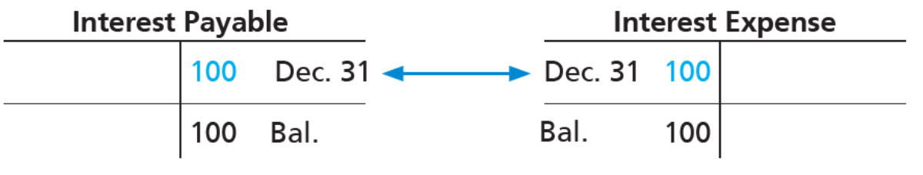
Accrued Interest Expense (3 of 3)
After the adjusting entry posts, Interest Expense and Interest Payable now have the following correct balances:
Notes:
The adjusting entry records a credit to the liability, Interest Payable. This is because the interest payment will not be made until next year; therefore, Smart Touch Learning owes interest to the bank. Had the adjusting entry not been recorded, liabilities and expenses would have been understated.
Line 2, End credit balance, 100. The 100 credit in the interest payable t-account is in the debit column of the interest expense t-account. Interest expense. Line 1, debit, December 31, 100. Credit, blank. Line 2, End debit balance, 100.

Slide 44
Accrued Revenues (1 of 4)
Accrued revenues arise when:
A company performs a service but has not yet collected cash
A company delivers a product but has not yet collected cash
Record accrued revenues with a:
Debit to Accounts Receivable
Credit to Service Revenue
Notes:
Accrued revenue occurs when the company earns revenue, usually as a result of performing services or delivering products to a customer, before receiving payment. If the revenue has been earned, it is recorded even if payment has not been received from the customer. Accrued revenue entries generally require a debit to the customer’s Accounts Receivable and a credit to a Revenue account.

Slide 45
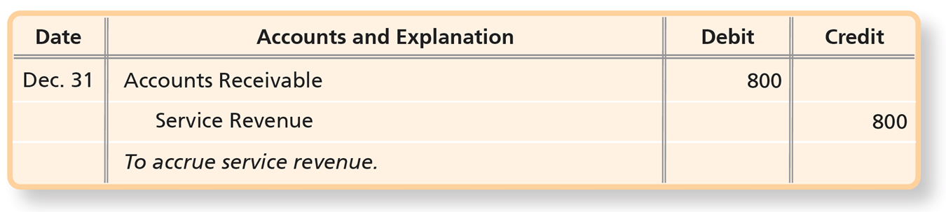
Accrued Revenues (2 of 4)
Smart Touch Learning is hired on December 15 to perform e-learning services, beginning on December 16. The business will earn $1,600 monthly and receive payment on January 15. As of December 31, $800 is earned. Adjusting entry:
Notes:
Smart Touch Learning is hired on December 15 to perform e-learning services, beginning on December 16. Under this agreement, the business will earn $1,600 monthly and receive payment on January 15. At the date of hiring, Smart Touch Learning does not record a journal entry because revenue has not yet been earned. During December, it will earn half a month’s fee, $800, for work December 16 through December 31.
The entry is as follows.
A table has 3 rows and 4 columns. The columns have the following headings from left to right. Date , Accounts and explanation , Debit , Credit . The row entries are as follows. Row 1. Date , December 31. Accounts and explanation , Accounts receivable . Debit , 800. Credit , Blank. Row 2. Date , Blank. Accounts and explanation , Service revenue . Debit , Blank. Credit , 800. Row 3. Date , Blank. Accounts and explanation , To accrue service revenue . Debit , Blank. Credit , Blank.

Slide 46
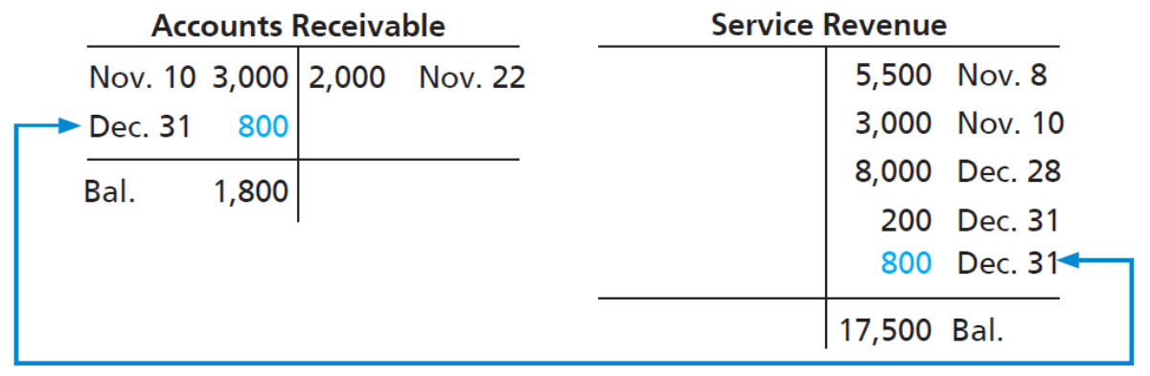
Accrued Revenues (3 of 4)
Smart Touch Learning’s account balances after posting the adjusting entry are:
Notes:
The adjusting entry records the earned revenue and brings the balance of the Service Revenue account to $17,500. In addition, the adjusting entry records an additional $800 account receivable. Smart Touch Learning did not record cash because the business has not yet received payment on the services provided. The cash will not be received until January 15.
Without the adjustment, Smart Touch Learning’s financial statements would understate both an asset, Accounts Receivable, and a revenue, Service Revenue.
Credit, 2,000, November 22. Line 2, debit, December 31, 800. Credit, blank. Line 3, end debit balance, 1,800. The 800 in the debit column of accounts receivable is in the credit column of service revenue. Service revenue. Line 1, debit, blank. Credit, 5,500, November 8. Line 2, debit, blank. Credit, 3,000, November 10. Line 3, debit, blank. Credit, 8,000, December 28. Line 4, debit, blank. Credit, 200, December 31. Line 5, debit, blank. Credit, 800, December 31. Line 6, end balance credit, 17,500.

Slide 47
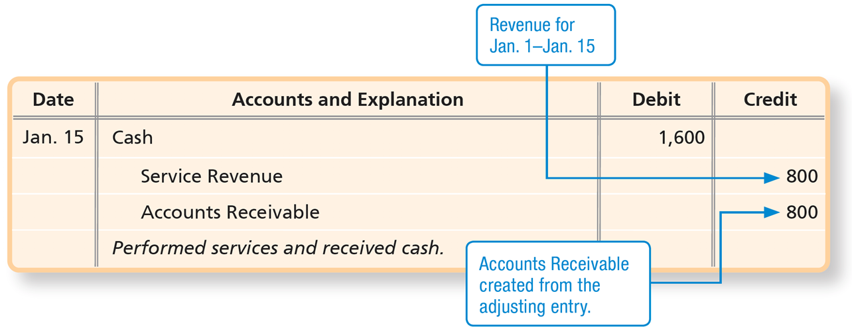
Accrued Revenues (4 of 4)
When Smart Touch Learning receives the payment on January 15, the business will record the following entry:
Notes:
The adjusting entry on December 31 records revenue earned for half a month and also creates an accounts receivable. When Smart Touch Learning receives the payment on January 15, the business will record cash received.
Notice that on January 15, Smart Touch Learning records revenue only for the remaining half of the month (January 1–January 15). Smart Touch Learning recognizes that $800 of revenue was already recorded in December. The entry on January 15 removes the accounts receivable and records the remaining revenue. If the business had incorrectly recorded $1,600 of Service Revenue on January 15, the revenue would have been overstated in January.
The entry is as follows.
A table has 4 rows and 4 columns. The columns have the following headings from left to right. Date , Accounts and explanation , Debit , Credit . The row entries are as follows. Row 1. Date , January 15. . Accounts and explanation , Cash . Debit , 1600. Credit , Blank. Row 2. Date , Blank. Accounts and explanation , Service revenue . Debit , Blank. Credit , 800. Row 3. Date , Blank. Accounts and explanation , Accounts receivable . Debit , Blank. Credit , 800. Row 4. Date , Blank. Accounts and explanation , Performed service and received cash . Debit , Blank. Credit , Blank.
The credit amount for service revenue is labeled, revenue for January 1 to January 15. The credit amount for accounts receivable is labeled, accounts receivable created from the adjusting entry. Assets = Liabilities + Equity. Assets column displays an increase in cash and decrease in accounts receivable. Equity column displays an increase in service revenue.

Slide 48
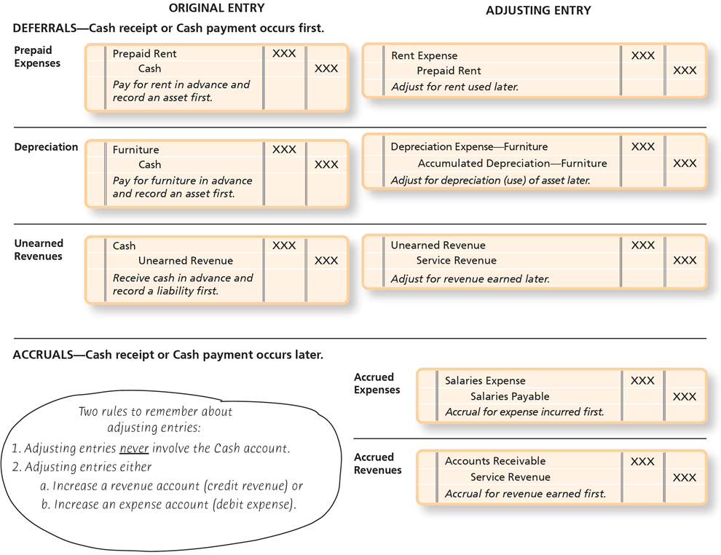
Exhibit F:3-3 Deferral and Accrual Adjustments
Notes:
Exhibit F:3-3 is a summary of the deferral and accrual adjusting entries.
The original entry and the corresponding adjusting entry is shown for the deferral adjustments. For example, the asset account, Prepaid Rent, is a debit and Cash is the credit in the original entry. When the rent is used, the Prepaid Rent account is adjusted with a credit, which decreases the value of the asset. A debit to Rent Expense captures the usage of the building.
Accrual entries do not have an original entry. They are adjustments for revenues earned but not yet collected and expenses incurred but not yet paid.
The exhibit is divided into two parts deferrals and accruals. In deferrals, the cash receipt or cash payment occurs first. In accruals, the cash receipt or cash payment occurs later. In case of deferrals, the original entry and adjusting entry. The original entry for prepaid expenses is as follows.
A table has 3 rows and 0 columns. The columns have the following headings from left to right. The row entries are as follows. Row 1. , Blank. , Prepaid rent . , No value . , Blank. Row 2. , Blank. , Cash . , Blank . , No value . Row 3. , Blank. , Pay for rent in advance and record an asset first. . , Blank. , Blank.
The adjusting entry for prepaid expenses is as follows.
A table has 3 rows and 0 columns. The columns have the following headings from left to right. The row entries are as follows. Row 1. , Blank. , Rent expense . , No value . , Blank. Row 2. , Blank. , Prepaid rent . , Blank . , No value . Row 3. , Blank. , Adjust for rent used later . , Blank. , Blank.
The original entry for depreciation is as follows.
A table has 3 rows and 0 columns. The columns have the following headings from left to right. The row entries are as follows. Row 1. , Blank. , Furniture . , No value . , Blank. Row 2. , Blank. , Cash . , Blank . , No value . Row 3. , Blank. , Pay for furniture in advance and record an asset first. . , Blank. , Blank.
The adjusting entry for depreciation is as follows.
A table has 3 rows and 0 columns. The columns have the following headings from left to right. The row entries are as follows. Row 1. , Blank. , Depreciation expense - furniture . , No value . , Blank. Row 2. , Blank. , Accumulated depreciation-furniture . , Blank . , No value . Row 3. , Blank. , Adjust for depreciation of asset later . , Blank. , Blank.
The original entry for unearned revenues is as follows.
A table has 3 rows and 0 columns. The columns have the following headings from left to right. The row entries are as follows. Row 1. , Blank. , Cash . , No value . , Blank. Row 2. , Blank. , Unearned revenue . , Blank . , No value . Row 3. , Blank. , Receive cash in advance and record a liability first . , Blank. , Blank.
The adjusting entry for unearned revenues is as follows.
A table has 3 rows and 0 columns. The columns have the following headings from left to right. The row entries are as follows. Row 1. , Blank. , Unearned revenue . , No value . , Blank. Row 2. , Blank. , Service revenue . , Blank . , No value . Row 3. , Blank. , Adjust for revenue earned later . , Blank. , Blank.
The entries under accruals sections are as follows.
For accrued expenses,
A table has 3 rows and 0 columns. The columns have the following headings from left to right. The row entries are as follows. Row 1. , Blank. , Salaries expense . , No value . , Blank . Row 2. , Blank. , Salaries payable . , Blank . , No value . Row 3. , Blank. , Accrual for expense incurred first . , Blank. , Blank.
For accrued revenues,
A table has 3 rows and 0 columns. The columns have the following headings from left to right. The row entries are as follows. Row 1. , Blank. , Accounts receivable . , No value . , Blank . Row 2. , Blank. , Service revenue . , Blank . , No value . Row 3. , Blank. , Accrual for revenue earned first . , Blank. , Blank.
The text reads, Two rules to remember about adjusting entries, 1. Adjusting entries never involve the Cash account. 2. Adjusting entries either increase a revenue account (credit revenue) or increase an expense account (debit expense).

Slide 49
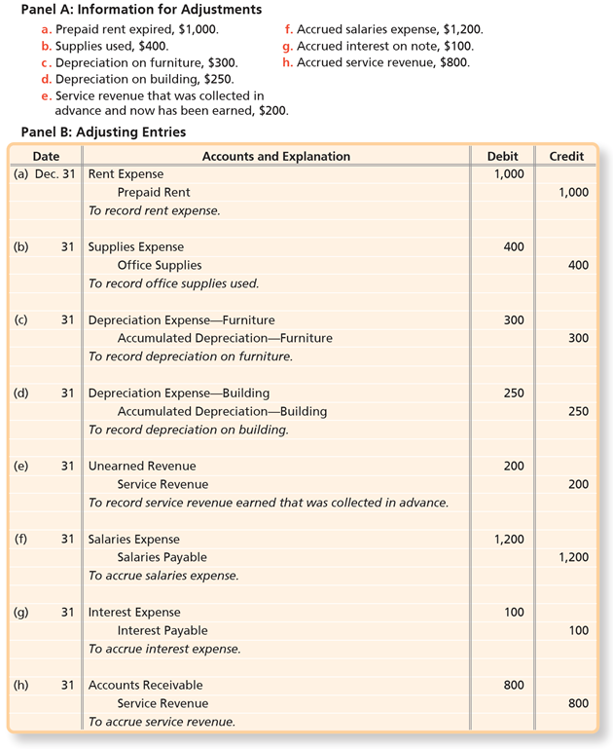
Exhibit F:3-4 Journalizing and Posting the Adjusting Entries of Smart Touch Learning (1 of 2)
(a)‒(d) are deferred expenses
(e) represents deferred revenue
(f) and (g) are accrued expenses
(h) is accrued revenue
Notes:
Adjustments to the unadjusted trial balance are accomplished using adjusting entries. Mechanically, adjusting entries are similar other journal entries. First, the accounts to be adjusted are identified. Then a determination is made as to whether to debit or credit each account. Then the adjusting entry is created and posted to the general ledger.
Exhibit F:3-4 is a summary of the adjusting entries discussed throughout the chapter. Entries (a)–(d) are examples of deferred expenses. Item (e) is a deferred revenue adjustment. Entries (f) and (g) are accrued expenses, and entry (h) is an accrued revenue adjustment.
Panel A gives the data for each adjustment.
Panel B shows the adjusting entries.
There are three panels in the exhibit. Panel A displays information for adjustments. The information is as follows. a. Prepaid rent expired, $1,000. b. Supplies used, $400. c. Depreciation on furniture, $300. d. Depreciation on building, $250. e. Service revenue that was collected in advance and now has been earned, $200. f. Accrued salaries expense, $1,200. g. Accrued interest on note, $100. h. Accrued service revenue, $800.
Panel B displays adjusting entries. The entries are as follows.
A table has 24 rows and 4 columns. The columns have the following headings from left to right. Date , Accounts and explanation , Debit , Credit . The row entries are as follows. Row 1. Date , a. December 31 . Accounts and explanation , Rent expense . Debit , 1000. Credit , Blank. Row 2. Date , Blank. Accounts and explanation , Prepaid rent . Debit , Blank. Credit , 1000. Row 3. Date , Blank. Accounts and explanation , To record rent expense . Debit , Blank. Credit , Blank. Row 4. Date , b. December 31 . Accounts and explanation , Supplies expense . Debit , 400. Credit Row 5. Date , Blank. Accounts and explanation , Office supplies . Debit , Blank. Credit , 400. Row 6. Date , Blank. Accounts and explanation , To record office supplies used . Debit , Blank. Credit , Blank. Row 7. Date , c. December 31. Accounts and explanation , Depreciation expense furniture . Debit , 300. Credit , Blank. Row 8. Date , Blank. Accounts and explanation , Accumulated depreciation furniture . Debit , Blank. Credit , 300. Row 9. Date , Blank. Accounts and explanation , To record depreciation on furniture . Debit , Blank. Credit , Blank. Row 10. Date , d. December 31 . Accounts and explanation , Depreciation expense building . Debit , 250. Credit , Blank. Row 11. Date , Blank. Accounts and explanation , Accumulated depreciation building . Debit , Blank. Credit , 250. Row 12. Date , Blank. Accounts and explanation , To record depreciation on building . Debit , Blank. Credit , Blank. Row 13. Date , e. December 31. Accounts and explanation , Unearned revenue. Debit , 200. Credit , Blank. Row 14. Date , Blank. Accounts and explanation , Service revenue. Debit , Blank. Credit , 200. Row 15. Date , Blank. Accounts and explanation , To record service revenue earned that was collected in advance . Debit , Blank. Credit , Blank. Row 16. Date , f. December 31 . Accounts and explanation , Salaries expense . Debit , 1200. Credit , Blank. Row 17. Date , Blank. Accounts and explanation , Salaries payable . Debit , Blank. Credit , 1200. Row 18. Date , Blank. Accounts and explanation , To accrue salaries expense . Debit , Blank. Credit , Blank. Row 19. Date , g. December 31. Accounts and explanation , Interest expense . Debit , 100. Credit , Blank. Row 20. Date , Blank. Accounts and explanation , Interest payable . Debit , Blank. Credit , 100. Row 21. Date , Blank. Accounts and explanation , To accrue interest expense . Debit , Blank. Credit , Blank. Row 22. Date , h. December 31 . Accounts and explanation , Accounts receivable . Debit , 800. Credit , Blank. Row 23. Date , Blank. Accounts and explanation , Service revenue . Debit , Blank. Credit , 800. Row 24. Date , Blank. Accounts and explanation , To accrue service revenue . Debit , Blank. Credit , Blank.

Slide 50
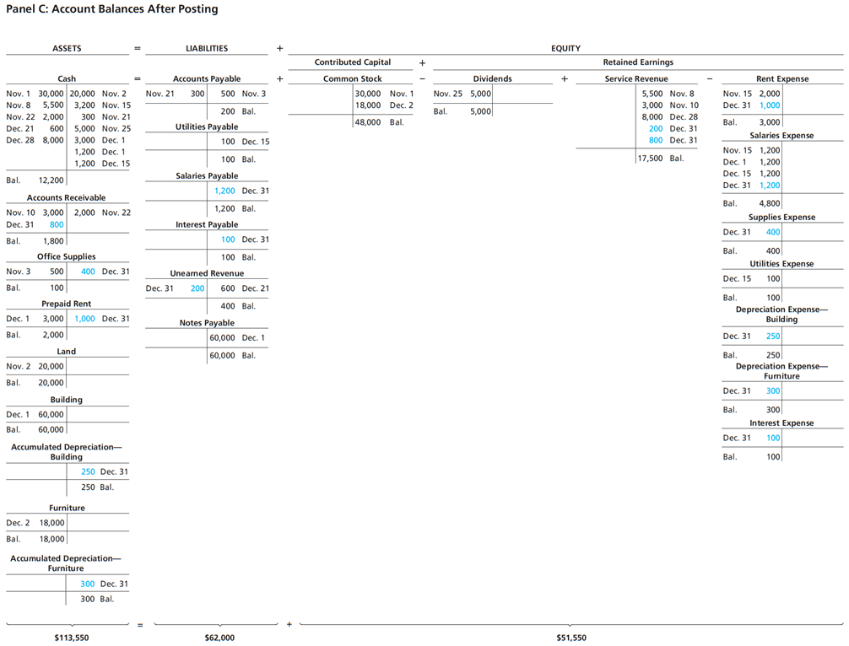
Exhibit F:3-4 Journalizing and Posting the Adjusting Entries of Smart Touch Learning (2 of 2)
Notes:
Panel C of Exhibit F:3-4 shows the T-accounts and balances after posting.
This is the continuation of the above exhibit.
The exhibit displays the panel 3 in which different T accounts with balances are represented in the form of equation Assets = Liabilities + Equity.
The T accounts under assets are given.
Cash account is as follows.
A table has 8 rows and 0 columns. The columns have the following headings from left to right. The row entries are as follows. Row 1. , November 1. , 30000. , November 2. , 20000. Row 2. , November 8. , 5500. , November 15 . , 3200. Row 3. , November 22. , 2000. , November 21. , 300. Row 4. , December 21. , 600. , November 25. , 5000. Row 5. , December 28. , 8000. , December 1. , 3000. Row 6. , Blank. , Blank . , December 1. , 1200. Row 7. , Blank . , Blank . , December 15. , 1200. Row 8. , Balance . , 12200. , Blank. , Blank.
Accounts receivable account is as follows.
A table has 3 rows and 0 columns. The columns have the following headings from left to right. The row entries are as follows. Row 1. , November 10. , 3000. , November 22. , 2000. Row 2. , December 31. , 800. , Blank . , Blank . Row 3. , Balance . , 1800. , Blank. , Blank.
The office supplies account is as follows.
A table has 2 rows and 0 columns. The columns have the following headings from left to right. The row entries are as follows. Row 1. , November 3. , 500. , December 31. , 400. Row 2. , Balance . , 100. , Blank. , Blank.
The prepaid rent account is as follows.
A table has 2 rows and 0 columns. The columns have the following headings from left to right. The row entries are as follows. Row 1. , December 1. , 3000. , December 31. , 1000. Row 2. , Balance . , 2000. , Blank . , Blank .
The land account is as follows.
A table has 2 rows and 0 columns. The columns have the following headings from left to right. The row entries are as follows. Row 1. , November 2. , 20000. , Blank . , Blank . Row 2. , Balance . , 20000. , Blank . , Blank .
The building account is as follows.
A table has 2 rows and 0 columns. The columns have the following headings from left to right. The row entries are as follows. Row 1. , December 1. , 60000. , Blank . , Blank . Row 2. , Balance . , 60000. , Blank . , Blank .
The accumulated depreciation building account is as follows.
A table has 2 rows and 0 columns. The columns have the following headings from left to right. The row entries are as follows. Row 1. , Blank . , Blank . , December 31. , 250. Row 2. , Blank . , Blank . , Balance . , 250.
The furniture account is as follows.
A table has 2 rows and 0 columns. The columns have the following headings from left to right. The row entries are as follows. Row 1. , December 2. , 18. , Blank . , Blank . Row 2. , Balance . , 18000. , Blank . , Blank .
The accumulated depreciation furniture account is as follows.
A table has 2 rows and 0 columns. The columns have the following headings from left to right. The row entries are as follows. Row 1. , Blank . , Blank . , December 31. , 300. Row 2. , Blank. , Blank. , Balance . , 300.
The T accounts under liabilities are given.
The accounts payable account is as follows.
A table has 2 rows and 0 columns. The columns have the following headings from left to right. The row entries are as follows. Row 1. , November 21 . , 300. , November 3. , 500. Row 2. , Blank . , Blank . , Balance. , 200.
The utilities payable account is as follows.
A table has 2 rows and 0 columns. The columns have the following headings from left to right. The row entries are as follows. Row 1. , Blank . , Blank . , December 15. , 100. Row 2. , Blank . , Blank . , Balance. , 100.
The salaries payable account is as follows.
A table has 2 rows and 0 columns. The columns have the following headings from left to right. The row entries are as follows. Row 1. , Blank . , Blank . , December 31. , 1200. Row 2. , Blank . , Blank . , Balance. , 1200.
The interest payable account is as follows.
A table has 2 rows and 0 columns. The columns have the following headings from left to right. The row entries are as follows. Row 1. , Blank . , Blank . , December 31. , 100. Row 2. , Blank . , Blank . , Balance. , 100.
The unearned revenue account is as follows.
A table has 2 rows and 0 columns. The columns have the following headings from left to right. The row entries are as follows. Row 1. , December 31. , 200. , December 21. , 600. Row 2. , Blank . , Blank . , Balance. , 400.
The notes payable account is as follows.
A table has 2 rows and 0 columns. The columns have the following headings from left to right. The row entries are as follows. Row 1. , Blank . , Blank . , December 1. , 60000. Row 2. , Blank . , Blank . , Balance. , 60000.
Equity is divided into Bright, Capital minus Bright, Withdrawals + service revenue minus rent expense. The Bright, Capital account is as follows.
A table has 3 rows and 0 columns. The columns have the following headings from left to right. The row entries are as follows. Row 1. , Blank. , Blank. , November 1 . , 30000. Row 2. , Blank. , Blank. , December 2. , 18000. Row 3. , Blank . , Blank. , Balance . , 48000.
The Bright, Withdrawals account is as follows.
A table has 2 rows and 0 columns. The columns have the following headings from left to right. The row entries are as follows. Row 1. , November 25. , 5000. , Blank . , Blank . Row 2. , Balance . , 5000. , Blank . , Blank .
The service revenue account is as follows.
A table has 6 rows and 0 columns. The columns have the following headings from left to right. The row entries are as follows. Row 1. , Blank . , Blank . , November 8 . , 5500. Row 2. , Blank. , Blank. , November 10. , 3000. Row 3. , Blank. , Blank. , December 28. , 8000. Row 4. , Blank. , Blank. , December 31. , 200. Row 5. , Blank. , Blank. , December 31. , 800. Row 6. , Blank. , Blank. , Balance. , 17500.
The rent expense account is as follows.
A table has 3 rows and 0 columns. The columns have the following headings from left to right. The row entries are as follows. Row 1. , November 15. , 2000. , Blank . , Blank. Row 2. , December 31. , 1000. , Blank. , Blank. Row 3. , Balance . , 3000. , Blank. , Blank.
The salaries expense account is as follows.
A table has 5 rows and 0 columns. The columns have the following headings from left to right. The row entries are as follows. Row 1. , November 15. , 1200. , Blank. , Blank. Row 2. , December 1. , 1200. , Blank. , Blank. Row 3. , December 15. , 1200. , Blank. , Blank. Row 4. , December 31. , 1200. , Blank. , Blank. Row 5. , Balance . , 4800. , Blank. , Blank.
The supplies expense account is as follows.
A table has 2 rows and 0 columns. The columns have the following headings from left to right. The row entries are as follows. Row 1. , December 31. , 400. , Blank . , Blank . Row 2. , Balance . , 400. , Blank . , Blank .
The utilities expense account is as follows.
A table has 2 rows and 0 columns. The columns have the following headings from left to right. The row entries are as follows. Row 1. , December 15. , 100. , Blank . , Blank . Row 2. , Balance . , 100. , Blank . , Blank .
The depreciation expense building account is as follows.
A table has 2 rows and 0 columns. The columns have the following headings from left to right. The row entries are as follows. Row 1. , December 31. , 250. , Blank . , Blank . Row 2. , Balance . , 250. , Blank . , Blank .
The depreciation expense furniture account is as follows.
A table has 2 rows and 0 columns. The columns have the following headings from left to right. The row entries are as follows. Row 1. , December 31. , 300. , Blank . , Blank . Row 2. , Balance . , 300. , Blank . , Blank .
The interest expense account is as follows.
A table has 2 rows and 0 columns. The columns have the following headings from left to right. The row entries are as follows. Row 1. , December 31. , 100. , Blank . , Blank . Row 2. , Balance . , 100. , Blank . , Blank .
The total assets are $113,550. The total liabilities are $62,000. The total equity is $51,550.

Slide 51
Learning Objective 3.4
Explain the purpose of and prepare an adjusted trial balance

Slide 52
What Is the Purpose of the Adjusted Trial Balance, and How Do We Prepare It? (1 of 2)
At the end of the fiscal period, an adjusted trial balance is prepared.
An adjusted trial balance is a list of all the accounts with their adjusted balances.
The purpose is to ensure total debits equal total credits
Journalize adjusting entries
Post adjusting entries
Prepare adjusted trial balance
Notes:
The adjusted trial balance includes all of the adjusting journal entries associated with deferred expenses, deferred revenues, accrued expenses, and accrued revenues. The purpose of the adjusted trial balance is to ensure the debits and credits are equal. Even if the debits are equal to the credits, there could still be potential errors in the journaling or posting processes. The adjusted trial balance is used to create the financial statements prior to the closing process.

Slide 53
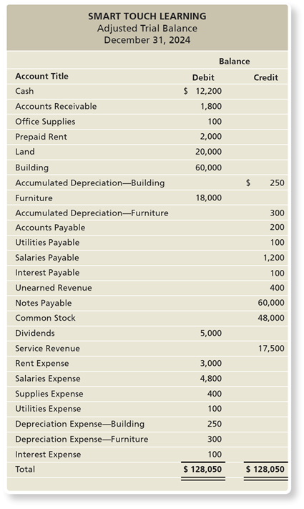
What Is the Purpose of the Adjusted Trial Balance, and How Do We Prepare It? (2 of 2)
The adjusted trial balance includes the balances after posting the adjusting journal entries.
Financial statements are prepared from the adjusted trial balance.
Exhibit F:3-5 Adjusted Trial Balance
Notes:
The debits are equal to the credits in the adjusted trial balance, which is similar to the unadjusted trial balance discussed in Chapter 2. The information from the adjusted trial balance is used to create the financial statements in the following order: income statement, statement of retained earnings, and the balance sheet.
The adjusted trial balance for Smart Touch Learning is shown in Exhibit F:3-5.
The adjusted trial balance is as follows.
A table has 27 rows and 3 columns. The columns have the following headings from left to right. Blank , Blank , Balance , . The row entries are as follows. Row 1. Blank , Account title . Blank , Debit . Balance , Credit . Row 2. Blank , Cash . Blank , $12,200. Balance , Blank . Row 3. Blank , Accounts receivable . Blank , 1800. Balance , Blank . Row 4. Blank , Office supplies. Blank , 100. Balance , Blank . Row 5. Blank , Prepaid rent . Blank , 2000. Balance , Blank. Row 6. Blank , Land . Blank , 20000. Balance , Blank. Row 7. Blank , Building . Blank , 60000. Balance , Blank. Row 8. Blank , Accumulated depreciation - building . Blank , Blank. Balance , $250. Row 9. Blank , Furniture . Blank , 18000. Balance , Blank. Row 10. Blank , Accumulated depreciation- building . Blank , Blank . Balance , $250. Row 11. Blank , Accounts payable . Blank , Blank . Balance , 200. Row 12. Blank , Utilities payable . Blank , Blank . Balance , 100. Row 13. Blank , Salaries payable . Blank , Blank . Balance , 12,00. Row 14. Blank , Interest payable . Blank , Blank . Balance , 100. Row 15. Blank , Unearned revenue . Blank , Blank . Balance , 400. Row 16. Blank , Notes payable . Blank , Blank . Balance , 60000. Row 17. Blank , Bright, Capital . Blank , Blank . Balance , 48000. Row 18. Blank , Bright, Withdrawals . Blank , 5000. Balance , Blank. Row 19. Blank , Service revenue . Blank , Blank. Balance , 17500. Row 20. Blank , Rent expense . Blank , 3000. Balance , Blank. Row 21. Blank , Salaries expense . Blank , 4800. Balance , Blank. Row 22. Blank , Supplies expense . Blank , 400. Balance , Blank. Row 23. Blank , Utilities expense . Blank , 100. Balance , Blank. Row 24. Blank , Depreciation expense building . Blank , 250. Balance , Blank. Row 25. Blank , Depreciation expense furniture . Blank , 300. Balance , Blank. Row 26. Blank , Interest expense . Blank , 100. Balance , Blank. Row 27. Blank , Total . Blank , $128,050. Balance , $128,050.

Slide 54
Learning Objective 3.5
Identify the impact of adjusting entries on the financial statements

Slide 55
What Is the Impact of Adjusting Entries on the Financial Statements? (1 of 2)
The adjusted trail balance is used to:
Confirm debits equal credits after adjusting entries
Ensure balance sheet items are properly valued
Failing to record adjusting entries results in incorrect financial statements.
See Exhibit F:3-6 (on the next slide) for examples.
Notes:
Failure to record the adjusting entries results in inaccurate financial statements. For example, if the adjustment for a deferred expense is not made, the asset account will be overstated and the expense account understated. This type of error results in an overstatement of net income because the expenses are too low. A summary of the impact on the financial statements is shown in Exhibit F:3-6 on the next slide.

Slide 56
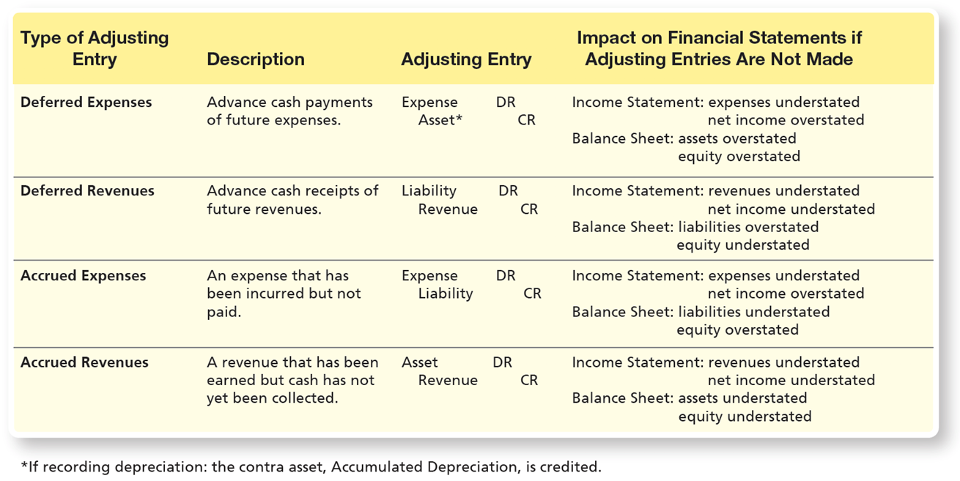
What Is the Impact of Adjusting Entries on the Financial Statements? (2 of 2)
Exhibit F:3-6 Impact of Adjusting Entries on Financial Statements
Notes:
The adjusting journal entries are absolutely necessary to the financial accounting and reporting process. Without them, many accounts will be understated, and others will be overstated. For example, if we fail to record accrued revenues, both the assets and the revenues (and subsequently the net income) will be understated. Or if we fail to record depreciation expense during the period, assets will be overstated, while expenses will be understated (i.e., too low), thereby resulting in an overstatement of net income.
A table has 4 rows and 4 columns. The columns have the following headings from left to right. Type of Adjusting Entry, Description, Adjusting Entry, Impact on Financial Statements if Adjusting Entries Are Not Made. The row entries are as follows. Row 1. Type of Adjusting Entry, Deferred expenses . Description, Advance cash payments of future expenses. Adjusting Entry, Expense debit , Asset credit , If recording depreciation, the contra asset, Accumulated Depreciation, is credited.. Impact on Financial Statements if Adjusting Entries Are Not Made, Income Statement, expenses understated net income overstated. Balance Sheet, assets overstated equity overstated. Row 2. Type of Adjusting Entry, Deferred Revenues. Description, Advance cash receipts of future revenues. Adjusting Entry, Liability debit, Revenue credit . Impact on Financial Statements if Adjusting Entries Are Not Made, Income Statement, revenues understated. Row 5. Type of Adjusting Entry, Accrued expenses . Description, An expense that has been incurred but not paid. . Adjusting Entry, Expense debit , Liability credit . Impact on Financial Statements if Adjusting Entries Are Not Made, Income Statement, expenses understated net income overstated Balance Sheet, liabilities understated equity overstated. Row 6. Type of Adjusting Entry, Accrued revenues . Description, A revenue that has been earned but cash has not yet been collected. . Adjusting Entry, Asset debit . Revenue credit . Impact on Financial Statements if Adjusting Entries Are Not Made, Income Statement, revenues understated net income understated Balance Sheet, assets understated equity understated.
A text below the table reads, Remember, Net income increases Owner, Capital, an equity account. Therefore, if net income is overstated, then equity will also be overstated. And if net income is understated, then equity will also be understated.

Slide 57
Learning Objective 3.6
Explain the purpose of a worksheet and use it to prepare adjusting entries and the adjusted trial balance

Slide 58
How Could a Worksheet Help in Preparing Adjusting Entries and the Adjusted Trial Balance?
A worksheet is an internal document that helps summarize data for the preparation of the financial statements.
The worksheet has four sections:
Account names
Unadjusted trial balance
Adjustments
Adjusted trial balance
Notes:
A worksheet is a useful tool to aid in preparing the adjusted trial balance. The worksheet provides columns for the unadjusted trial balance, the adjusting entries, and the adjusted trial balance. The worksheet is an internal document and is often prepared in Microsoft Excel.

Slide 59
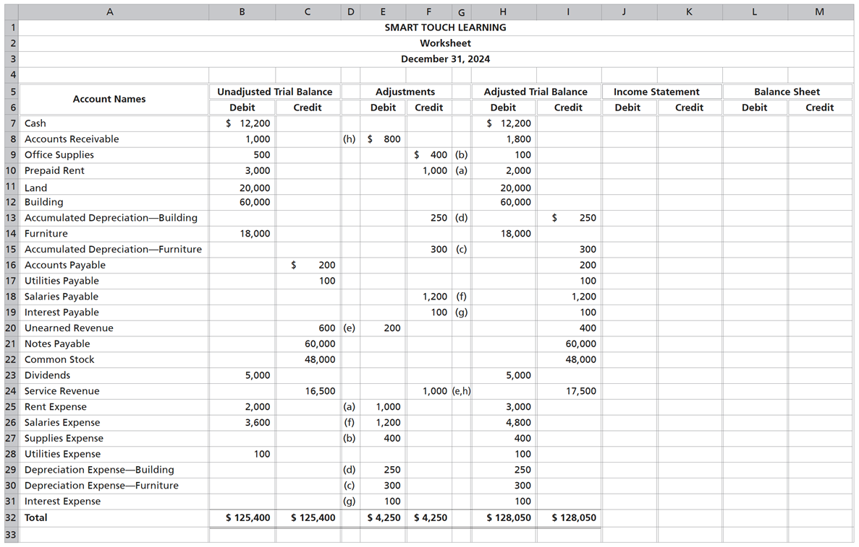
Exhibit F:3-7 Partially Completed Worksheet
Notes:
Exhibit F:3-7 is an example of a partially completed worksheet. This worksheet will be completed in Chapter 4.
In this chapter, we complete a part of the worksheet. For now, we will concern ourselves with the first four sections.
Section 1. Account names: The account names are taken from and listed in the same order as the chart of accounts. (Cash first, Accounts Receivable second, and so on.)
Section 2. Unadjusted trial balance: The account balances are copied directly from the ledger before any adjustments. Total debits must equal total credits.
Section 3. Adjustments: Enter the adjusting journal entries that were made on December 31.
Section 4. Adjusted trial balance: Gives the account balances after adjustments. Each amount in these columns is computed by combining the unadjusted trial balance amounts plus or minus the adjustments.
Note that the worksheet does not eliminate the need for recording the adjusting entries in the journal or posting them to the ledger. It is simply a tool to assist in evaluating the accounts and determining which accounts need adjustment.
The worksheet is as follows.
A table has 30 rows and 11 columns. The columns have the following headings from left to right. Blank, Blank, Smart Touch Learning , Blank, Blank, Blank, Blank, Blank, Blank, Blank, Blank, . The row entries are as follows. Row 1. Blank, Blank. Blank, Blank. Smart Touch Learning , Worksheet . Blank, Blank. Blank, Blank. Blank, Blank. Blank, Blank. Blank, Blank. Blank, Blank. Blank, Blank. Blank, Blank. Row 2. Blank, Blank. Blank, Blank. Smart Touch Learning , December 31, 20 24. Blank, Blank. Blank, Blank. Blank, Blank. Blank, Blank. Blank, Blank. Blank, Blank. Blank, Blank. Blank, Blank. Row 3. Blank, Account Names. Blank, Unadjusted Trial Balance . Smart Touch Learning , Blank. Blank, Adjustments . Blank, Blank. Blank, Adjusted trial balance . Blank, Blank. Blank, Income Statement. Blank, Blank. Blank, Balance Sheet . Blank, Blank. Row 4. Blank, Blank. Blank, Debit . Smart Touch Learning , Credit . Blank, Debit . Blank, Credit . Blank, Debit. Blank, Credit . Blank, Debit . Blank, Credit . Blank, Debit . Blank, Credit . Row 5. Blank, Cash . Blank, $12,200 . Smart Touch Learning , Blank. Blank, Blank. Blank, Blank. Blank, $12,200 . Blank, Blank. Blank, Blank. Blank, Blank. Blank, Blank. Blank, Blank. Row 6. Blank, Account s receivable . Blank, 1000. Smart Touch Learning , Blank. Blank, (h) 800. Blank, Blank. Blank, 1800. Blank, Blank. Blank, Blank. Blank, Blank. Blank, Blank. Blank, Blank. Row 7. Blank, Office Supplies . Blank, 500. Smart Touch Learning , Blank. Blank, Blank. Blank, (b)400. Blank, 100. Blank, Blank. Blank, Blank. Blank, Blank. Blank, Blank. Blank, Blank. Row 8. Blank, Prepaid Rent. Blank, 3000. Smart Touch Learning , Blank. Blank, Blank. Blank, (a)1,000. Blank, 2000. Blank, Blank. Blank, Blank. Blank, Blank. Blank, Blank. Blank, Blank. Row 9. Blank, Land. Blank, 20000. Smart Touch Learning , Blank. Blank, Blank. Blank, Blank. Blank, 20000. Blank, Blank. Blank, Blank. Blank, Blank. Blank, Blank. Blank, Blank. Row 10. Blank, Building . Blank, 60000. Smart Touch Learning , Blank. Blank, Blank. Blank, Blank. Blank, 60000. Blank, Blank. Blank, Blank. Blank, Blank. Blank, Blank. Blank, Blank. Row 11. Blank, Accumulated Depreciation building . Blank, Blank. Smart Touch Learning , Blank. Blank, Blank. Blank, (d)250. Blank, Blank. Blank, $250 . Blank, Blank. Blank, Blank. Blank, Blank. Blank, Blank. Row 12. Blank, Furniture . Blank, 18000. Smart Touch Learning , Blank. Blank, Blank. Blank, Blank. Blank, 18000. Blank, Blank. Blank, Blank. Blank, Blank. Blank, Blank. Blank, Blank. Row 13. Blank, Accumulated depreciation furniture . Blank, Blank. Smart Touch Learning , Blank. Blank, Blank. Blank, (c) 300. Blank, Blank. Blank, 300. Blank, Blank. Blank, Blank. Blank, Blank. Blank, Blank. Row 14. Blank, Accounts payable . Blank, Blank. Smart Touch Learning , $200 . Blank, Blank. Blank, Blank. Blank, Blank. Blank, 200. Blank, Blank. Blank, Blank. Blank, Blank. Blank, Blank. Row 15. Blank, Utilities payable . Blank, Blank . Smart Touch Learning , 100. Blank, Blank. Blank, Blank. Blank, Blank. Blank, 100. Blank, Blank. Blank, Blank. Blank, Blank. Blank, Blank. Row 16. Blank, Salaries payable . Blank, Blank. Smart Touch Learning , Blank. Blank, Blank. Blank, (f) 1,200 . Blank, Blank. Blank, 1200. Blank, Blank. Blank, Blank. Blank, Blank. Blank, Blank. Row 17. Blank, Interest payable . Blank, Blank. Smart Touch Learning , Blank. Blank, Blank. Blank, (g) 100 . Blank, Blank. Blank, 100. Blank, Blank. Blank, Blank. Blank, Blank. Blank, Blank. Row 18. Blank, Unearned revenue . Blank, Blank. Smart Touch Learning , 600. Blank, (e) 200. Blank, Blank. Blank, Blank. Blank, 400. Blank, Blank. Blank, Blank. Blank, Blank. Blank, Blank. Row 19. Blank, Notes payable . Blank, Blank. Smart Touch Learning , 60000. Blank, Blank. Blank, Blank. Blank, Blank. Blank, 60000. Blank, Blank. Blank, Blank. Blank, Blank. Blank, Blank. Row 20. Blank, Common stock . Blank, Blank. Smart Touch Learning , 48000. Blank, Blank. Blank, Blank. Blank, Blank. Blank, 48000. Blank, Blank. Blank, Blank. Blank, Blank. Blank, Blank. Row 21. Blank, Dividends . Blank, 5000. Smart Touch Learning , Blank. Blank, Blank. Blank, Blank. Blank, 5000. Blank, Blank. Blank, Blank. Blank, Blank. Blank, Blank. Blank, Blank. Row 22. Blank, Service revenue . Blank, Blank. Smart Touch Learning , 16500. Blank, (a) 1,000. Blank, 1,000 (e, h). Blank, Blank. Blank, 17500. Blank, Blank. Blank, Blank. Blank, Blank. Blank, Blank. Row 23. Blank, Rent expense . Blank, 2000. Smart Touch Learning , Blank. Blank, (f) 1,200. Blank, Blank. Blank, 3000. Blank, Blank. Blank, Blank. Blank, Blank. Blank, Blank. Blank, Blank. Row 24. Blank, Salaries expense . Blank, 3600. Smart Touch Learning , Blank. Blank, (b) 400. Blank, Blank. Blank, 4800. Blank, Blank. Blank, Blank. Blank, Blank. Blank, Blank. Blank, Blank. Row 25. Blank, Supplies expense . Blank, Blank. Smart Touch Learning , Blank. Blank, Blank. Blank, Blank. Blank, 400. Blank, Blank. Blank, Blank. Blank, Blank. Blank, Blank. Blank, Blank. Row 26. Blank, Utilities expense . Blank, 100. Smart Touch Learning , Blank. Blank, (d)250. Blank, Blank. Blank, 100. Blank, Blank. Blank, Blank. Blank, Blank. Blank, Blank. Blank, Blank. Row 27. Blank, Depreciation expense building. Blank, Blank. Smart Touch Learning , Blank. Blank, (c) 300. Blank, Blank. Blank, 250. Blank, Blank. Blank, Blank. Blank, Blank. Blank, Blank. Blank, Blank. Row 28. Blank, Depreciation expense furniture . Blank, Blank. Smart Touch Learning , Blank. Blank, (g) 100. Blank, Blank. Blank, 300. Blank, Blank. Blank, Blank. Blank, Blank. Blank, Blank. Blank, Blank. Row 29. Blank, Interest expense . Blank, Blank. Smart Touch Learning , Blank. Blank, Blank. Blank, Blank. Blank, 100. Blank, Blank. Blank, Blank. Blank, Blank. Blank, Blank. Blank, Blank. Row 30. Blank, Total . Blank, $125,400 . Smart Touch Learning , $125,400 . Blank, $4,250 . Blank, $4,250 . Blank, $128,050 . Blank, $128,050 . Blank, Blank. Blank, Blank. Blank, Blank. Blank, Blank.

Slide 60
Learning Objective 3.7
Understand the alternative treatment of recording deferred expenses and deferred revenues (Appendix 3A)

Slide 61
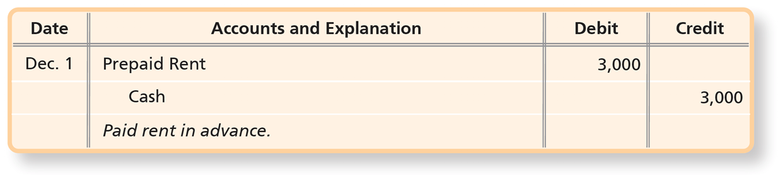
What Is an Alternative Treatment of Recording Deferred Expenses and Deferred Revenues?
Deferred Expenses
Recall that deferred expenses, also called prepaid expenses, are advance payments of future expenses.
When a business prepays an expense it can debit an asset account and defer the recognition of the expense.
For example, Smart Touch Learning prepaid three months of office rent totaling $3,000 on December 1, 2024. The journal entry can be recorded as:
Notes:
Recall that deferred expenses, also called prepaid expenses, are advance payments of future expenses, such as insurance, rent, and advertising. Office supplies are also accounted for as deferred expenses. The journal entry on this slide illustrate an example of debiting an asset (Prepaid Rent) when rent is paid in advance.
The entry is as follows.
A table has 3 rows and 4 columns. The columns have the following headings from left to right. Date , Accounts and explanation , Debit , Credit . The row entries are as follows. Row 1. Date , December 1. Accounts and explanation , Prepaid rent . Debit , 3000. Credit , Blank . Row 2. Date , Blank. Accounts and explanation , Cash . Debit , Blank. Credit , 3000. Row 3. Date , Blank. Accounts and explanation , Paid rent in advance . Debit , Blank. Credit , Blank.

Slide 62
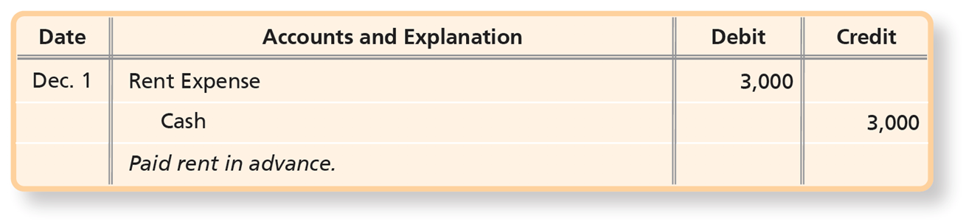
Deferred Expense Recorded Initially as an Expense (1 of 3)
The asset created by a deferred expense my be so short lived that it will expire in the current period.
Thus, the accountant may decide to debit the prepayment to an expense account at the time of payment.
The entry could, alternatively, be recorded as follows:
Notes:
Deferring an expense creates an asset. However, the asset may be so short lived that it will expire in the current accounting period—within one year or less. Thus, the accountant may decide to debit the prepayment to an expense account at the time of payment. The entry could, alternatively, be recorded as a debit to rent expense and a credit to cash.
The entry is as follows.
A table has 3 rows and 4 columns. The columns have the following headings from left to right. Date , Accounts and explanation , Debit , Credit . The row entries are as follows. Row 1. Date , December 1. Accounts and explanation , Rent expense . Debit , 3000. Credit , Blank . Row 2. Date , Blank. Accounts and explanation , Cash. Debit , Blank. Credit , 3000. Row 3. Date , Blank. Accounts and explanation , Paid rent in advance. Debit , Blank. Credit , Blank.

Slide 63
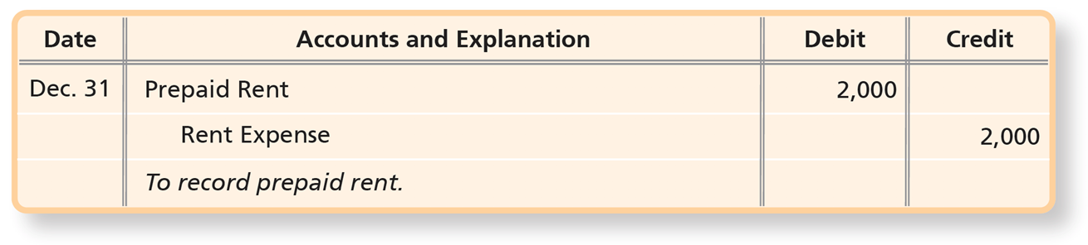
Deferred Expense Recorded Initially as an Expense (2 of 3)
As of December 31, only one month’s prepayment has expired, leaving two months of rent still prepaid. In this case, the accountant must transfer two-thirds of the original prepayment of $3,000, or $2,000, to the asset account Prepaid Rent with an adjusting entry:
Notes:
As of December 31, only one month’s prepayment has expired, leaving two months of rent still prepaid. In this case, the accountant must transfer two-thirds of the original prepayment of $3,000, or $2,000, to the asset account Prepaid Rent with an adjusting entry.
The entry is as follows.
A table has 3 rows and 4 columns. The columns have the following headings from left to right. Date , Accounts and explanation , Debit , Credit . The row entries are as follows. Row 1. Date , December 31. Accounts and explanation , Prepaid rent. Debit , 2000. Credit , Blank . Row 2. Date , Blank. Accounts and explanation , Rent expense. Debit , Blank. Credit , 2000. Row 3. Date , Blank. Accounts and explanation , To record prepaid rent . Debit , Blank. Credit , Blank.

Slide 64
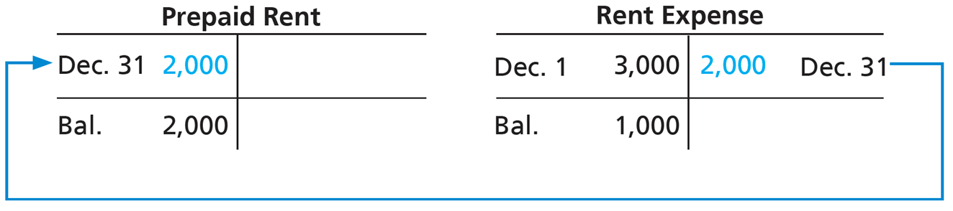
Deferred Expense Recorded Initially as an Expense (3 of 3)
After posting, the two accounts appear as follows:
Notes:
At December 31, the $3,000 prepayment is correctly divided as $2,000 of Prepaid Rent and $1,000 of Rent Expense, regardless of whether the business initially debits the prepayment to an asset or to an expense account.
A table has 1 rows and 2 columns. The columns have the following headings from left to right. December 31, 2000, Blank . The row entries are as follows. Row 1. December 31, 2000, Balance, 2,000. Blank , Blank .
The rent expense account is as follows.
A table has 1 rows and 2 columns. The columns have the following headings from left to right. December 1, 3000, December 31, 2000. The row entries are as follows. Row 1. December 1, 3000, Balance, 1,000. December 31, 2000, Blank.
The entry of December 31 in prepaid rent account is connected with the December 31 entry in rent expense account.

Slide 65
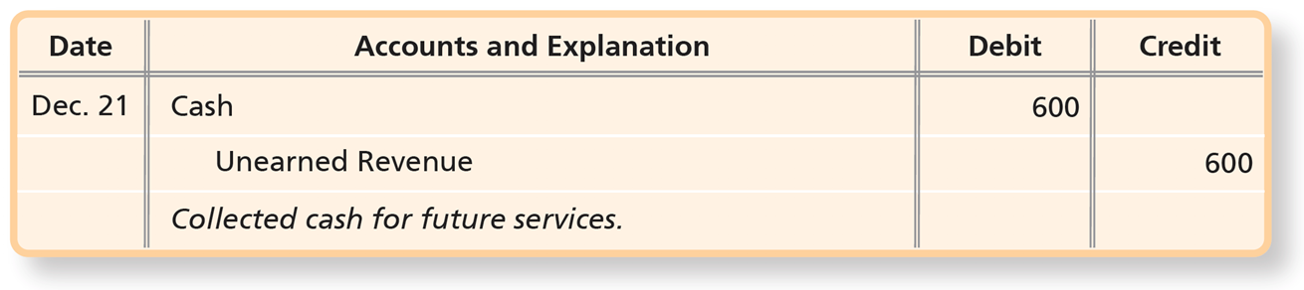
Deferred Revenues
Deferred revenues, also called unearned revenues, arise when a business collects cash before earning the revenue.
When a business receives cash in advance of providing services, a liability can be created.
For example, Smart Touch Learning is paid $600 in advance for monthly e-learning services on December 21.
Notes:
Deferred revenues, also called unearned revenues, arise when a business collects cash before earning the revenue. Deferred revenues are liabilities because the business that receives the cash owes the customer goods or services to be delivered later. When a business receives cash in advance of providing services, a liability can be created.
As an example, a law firm engages Smart Touch Learning to provide monthly e-learning services, agreeing to pay $600 in advance. Smart Touch Learning received the $600 on December 21 for services to be provided in the next 30 days. Smart Touch Learning records the entry shown on this slide, recognizing the liability and deferring the recognition of the revenue.
The entry is as follows.
A table has 3 rows and 4 columns. The columns have the following headings from left to right. Date , Accounts and explanation , Debit , Credit . The row entries are as follows. Row 1. Date , December 21. Accounts and explanation , Cash. Debit , 600. Credit , Blank . Row 2. Date , Blank. Accounts and explanation , Unearned revenue . Debit , Blank. Credit , 600. Row 3. Date , Blank. Accounts and explanation , Collected cash for future services. Debit , Blank. Credit , Blank.

Slide 66
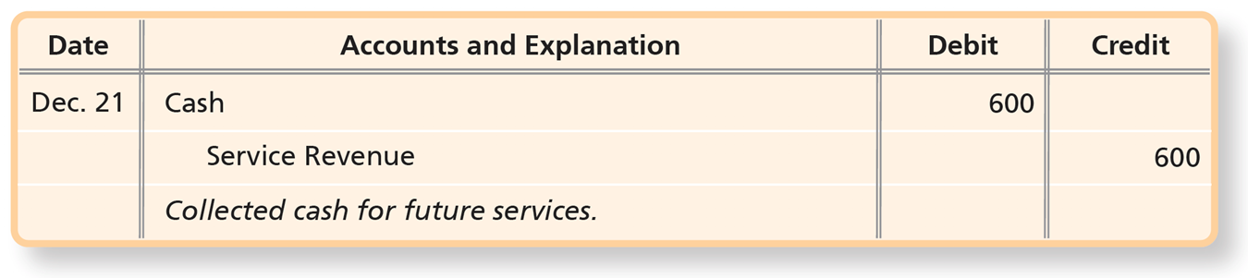
Deferred Revenues Recorded Initially as a Revenue (1 of 3)
Another way to account for the receipt of cash is to credit a revenue account when the business receives cash:
Notes:
Another way to account for the receipt of cash is to credit a revenue account when the business receives cash.
The entry is as follows.
A table has 3 rows and 4 columns. The columns have the following headings from left to right. Date , Accounts and explanation , Debit , Credit . The row entries are as follows. Row 1. Date , December 21. Accounts and explanation , Cash. Debit , 600. Credit , Blank . Row 2. Date , Blank. Accounts and explanation , Service revenue . Debit , Blank. Credit , 600. Row 3. Date , Blank. Accounts and explanation , Collected cash for future services . Debit , Blank. Credit , Blank.

Slide 67
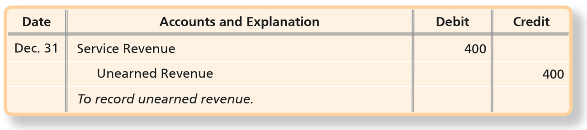
Deferred Revenues Recorded Initially as a Revenue (2 of 3)
If the business then earns all the revenue within the same accounting period, no adjusting entry is needed.
However, if the business earns only part of the revenue in that period, it must make an adjusting entry.
For example, if Smart Touch Learning earned only $200, by December 31:
Notes:
If the business then earns all the revenue within the same accounting period, no adjusting entry is needed at the end. However, if the business earns only part of the revenue in that period, it must make an adjusting entry. In our example, Smart Touch Learning has earned only one-third of the $600, or $200, by December 31. Accordingly, Smart Touch Learning must make an adjusting entry to transfer the unearned portion (2/3 of $600, or $400) from the revenue account to a liability.
The entry is as follows.
A table has 3 rows and 4 columns. The columns have the following headings from left to right. Date , Accounts and explanation , Debit , Credit . The row entries are as follows. Row 1. Date , December 31. Accounts and explanation , Service revenue . Debit , 400. Credit , Blank . Row 2. Date , Blank. Accounts and explanation , Unearned revenue . Debit , Blank. Credit , 400. Row 3. Date , Blank. Accounts and explanation , To record unearned revenue . Debit , Blank. Credit , Blank.

Slide 68
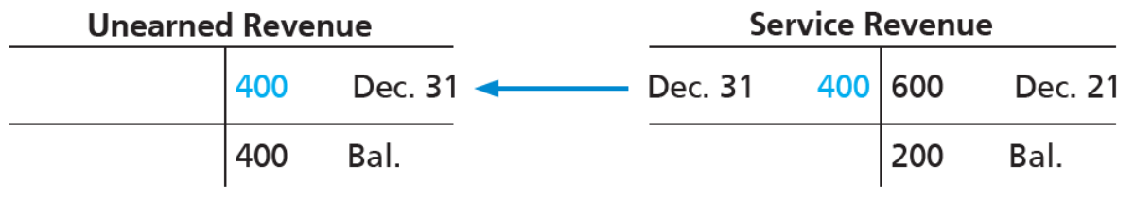
Deferred Revenues Recorded Initially as a Revenue (3 of 3)
After posting, the total amount, $600, is properly divided between the liability account—$400, and the revenue account—$200, as follows:
Notes:
The adjusting entry transfers the unearned portion of service revenue to the liability account because Smart Touch Learning still owes e-learning services next year. After posting, the total amount, $600, is properly divided between the liability account—$400, and the revenue account—$200.
At December 31, the $600 cash receipt is correctly divided: $400 of Unearned Revenue and $200 of Service Revenue, regardless of whether the business initially credits the cash receipt to a liability or to a revenue account.
Line 1, debit, blank. Credit, 400, December 31. Line 2, end credit balance, 400. Service revenue. Line 1, debit, December 31, 400. Credit, 600, December 21. Line 2, end credit balance, 200. The 400 in the debit column of service revenue is in the credit column of unearned revenue.

Slide 69

Copyright
This work is protected by United States copyright laws and is provided solely for the use of instructors in teaching their courses and assessing student learning. Dissemination or sale of any part of this work (including on the World Wide Web) will destroy the integrity of the work and is not permitted. The work and materials from it should never be made available to students except by instructors using the accompanying text in their classes. All recipients of this work are expected to abide by these restrictions and to honor the intended pedagogical purposes and the needs of other instructors who rely on these materials.

